Slide 1
#2013ATI
@aidtransparency
ati.publishwhatyoufund.org

Slide 2
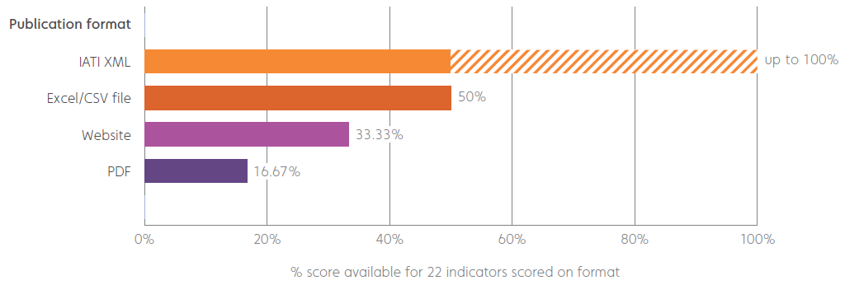
Publication format

Slide 4
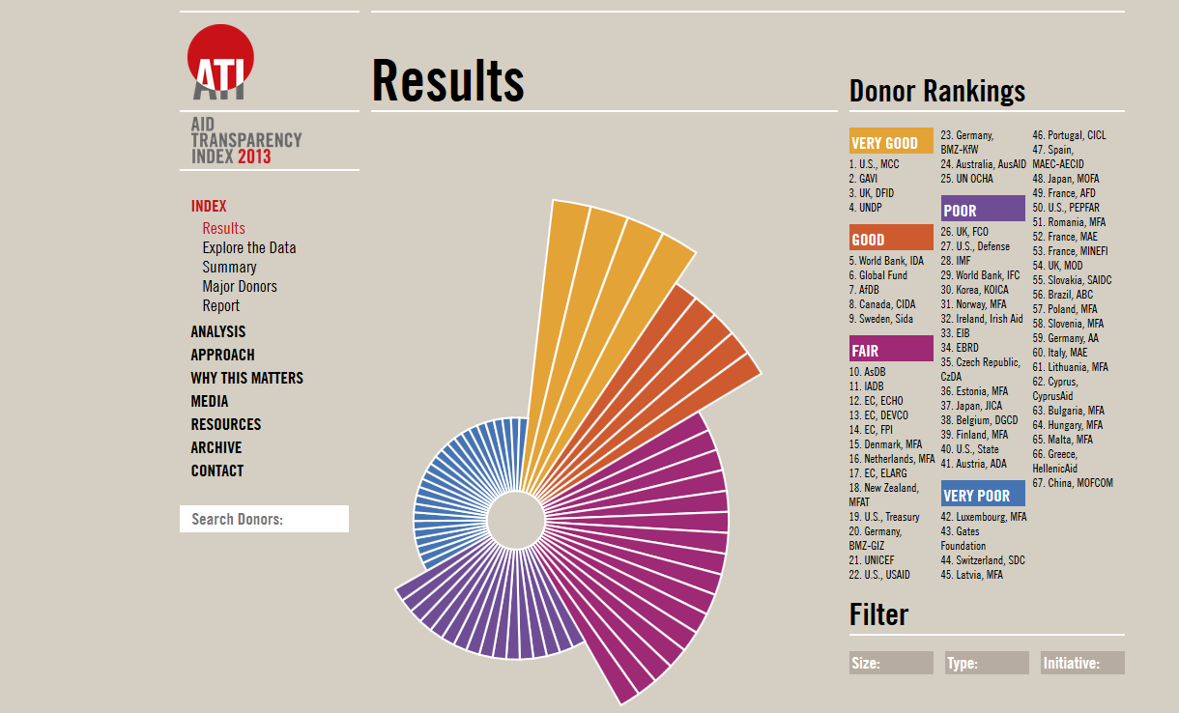

Slide 5
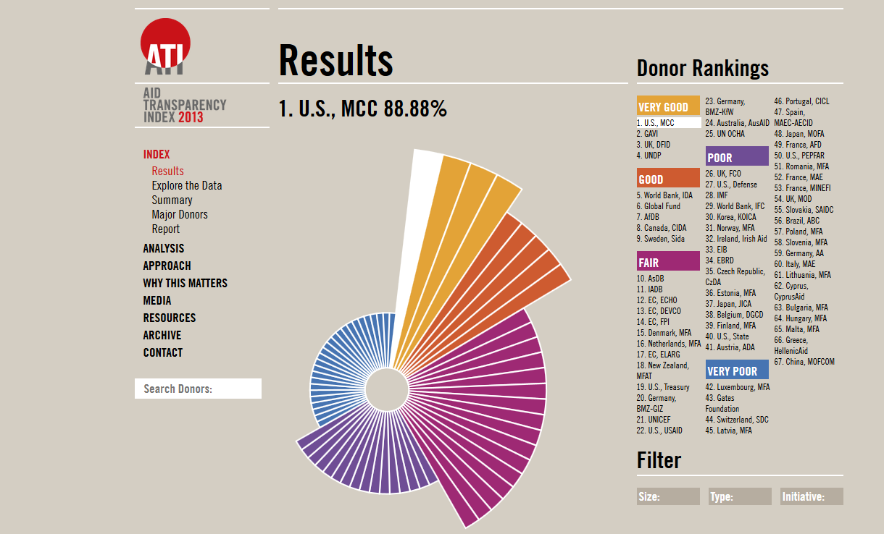

Slide 6
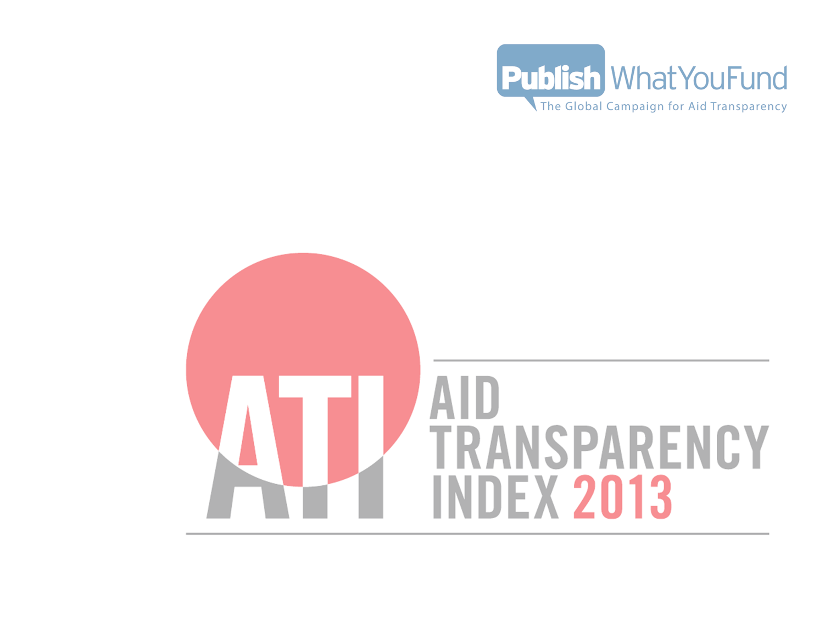
Conclusions

Slide 7
Recommendations

Slide 8
#2013ATI
@aidtransparency
ati.publishwhatyoufund.org
Notes:
We’ve discussed how we get IATI data. Now, what can you do with it?

Slide 9
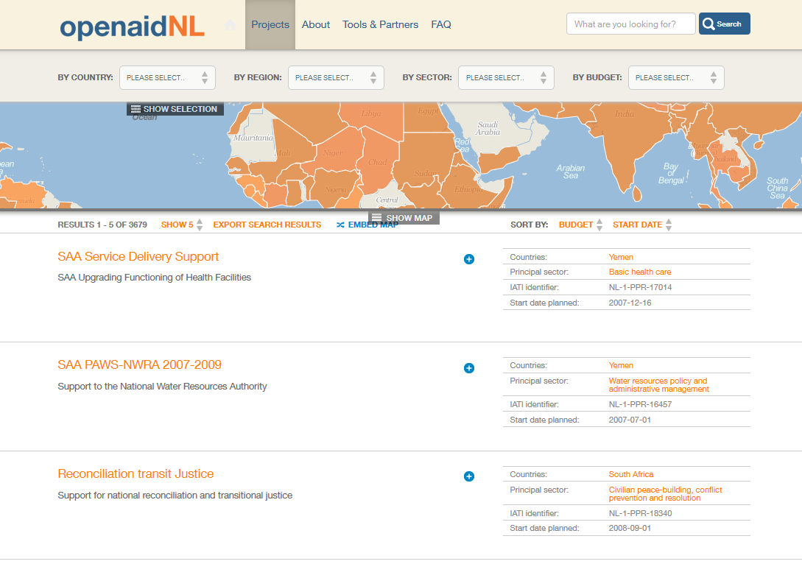
OpenAid.nl
Dutch Ministry of Foreign Affairs
Notes:
OpenAid.nl shows all projects funded by the Dutch Ministry of Foreign Affairs. As it’s open-source, any donor is free to take the source code and make their own website.

Slide 10
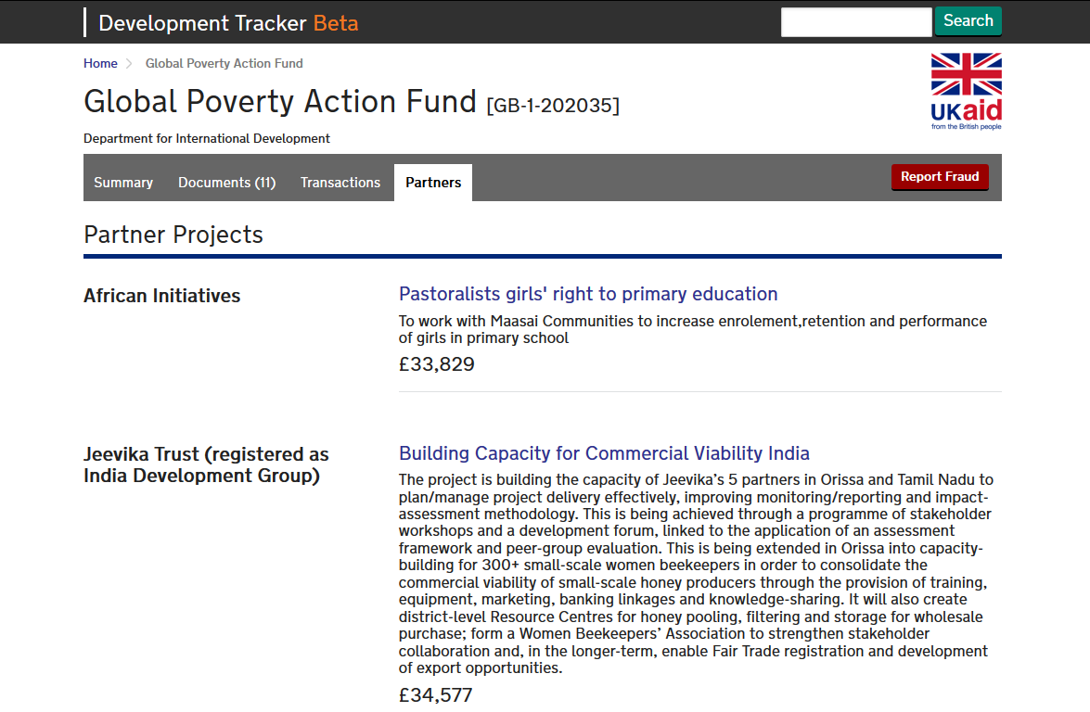
Development Tracker
UK Department for International Development
Notes:
DFID’s Dev Tracker, another open-source platform, has gone a step further in incorporating data from the implementing partners of DFID-funded projects. This lets you trace projects from donors to implementers.

Slide 11
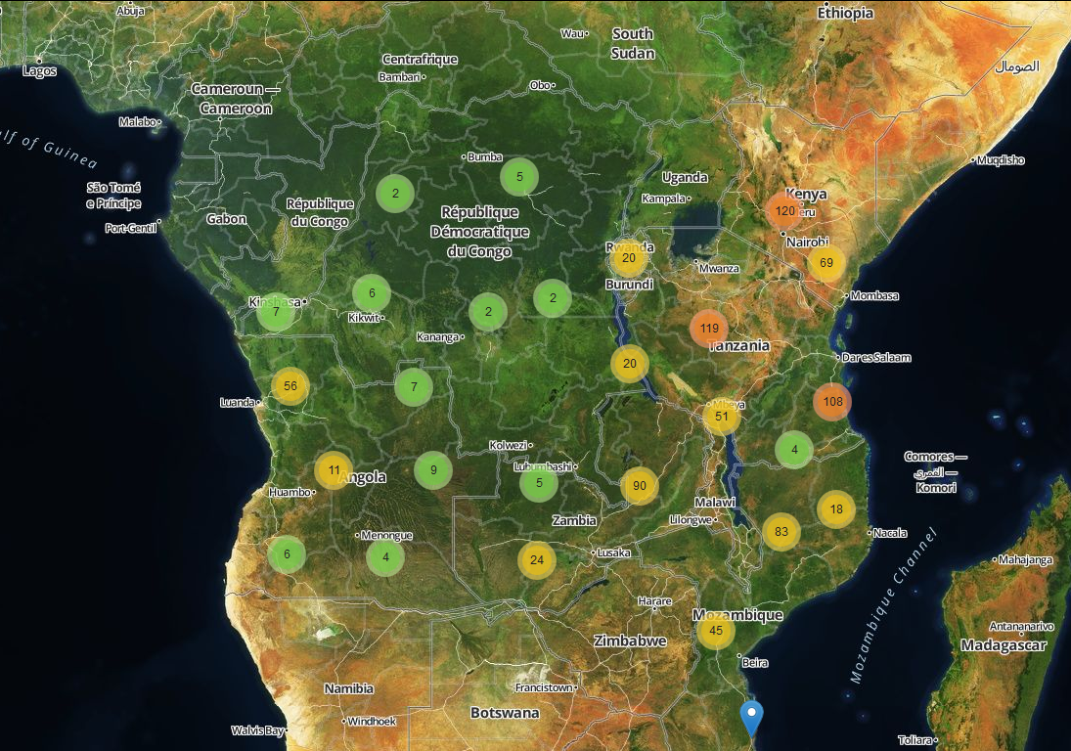
Projects in Africa
Publish What You Fund
Notes:
But we’re not just interested in data from a single donor; we want to integrate information from multiple donors. Publish What You Fund put this IATI visualisation together in one hour to show geo-coded projects across Africa from a few donors.

Slide 12
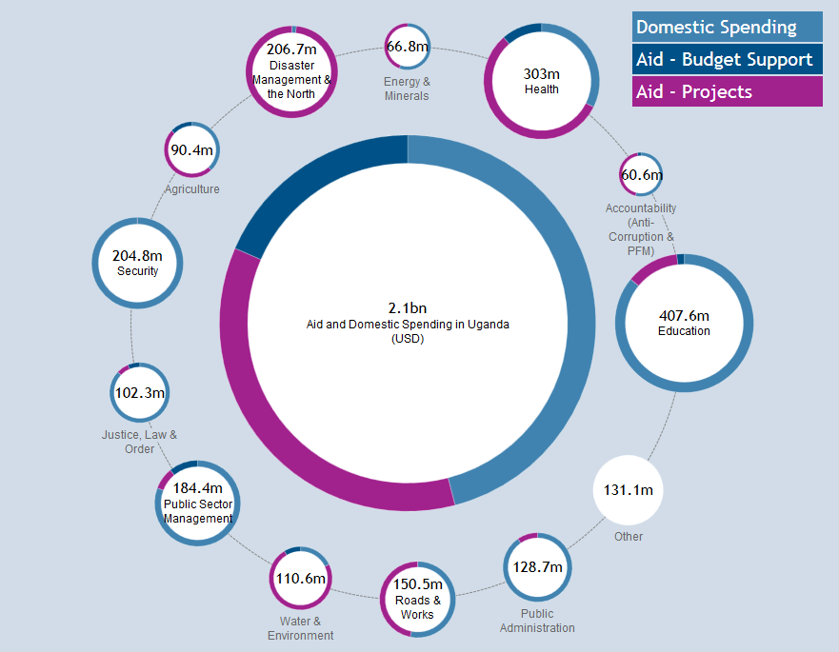
Uganda 2003-2007
ODI / Publish What You Fund
Notes:
And we’re not just interested in aid projects on their own. Publishing good data to IATI will help provide a more complete picture of resource flows available in developing countries. In 2007, this took eight months of manual data collection, and another six months to visualise aid flows and the domestic budget in Uganda. In time, IATI will allow us to do this at the click of a button.

Slide 13
#2013ATI
@aidtransparency
ati.publishwhatyoufund.org

