Slide 1
The Road to a New Global Climate Change Agreement: Challenges and Opportunities
Pascal Canfin
Deputy Minister for Development
Lead Climate Change Negotiator Government of France

Slide 2
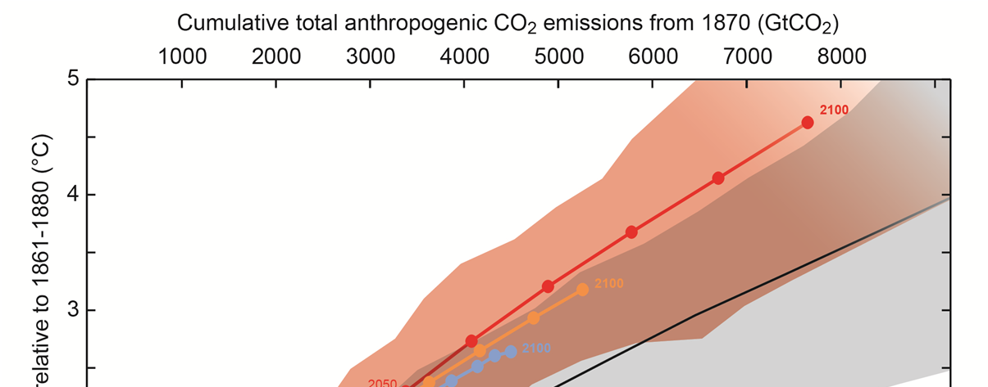
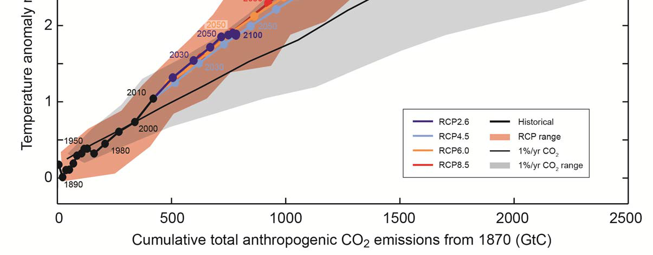
The core of Paris 2015 – staying below 2°C
The good news: Staying below 2°C is still possible !!!
The bad news: Current trajectory leads us to 4°C !!!

Slide 3
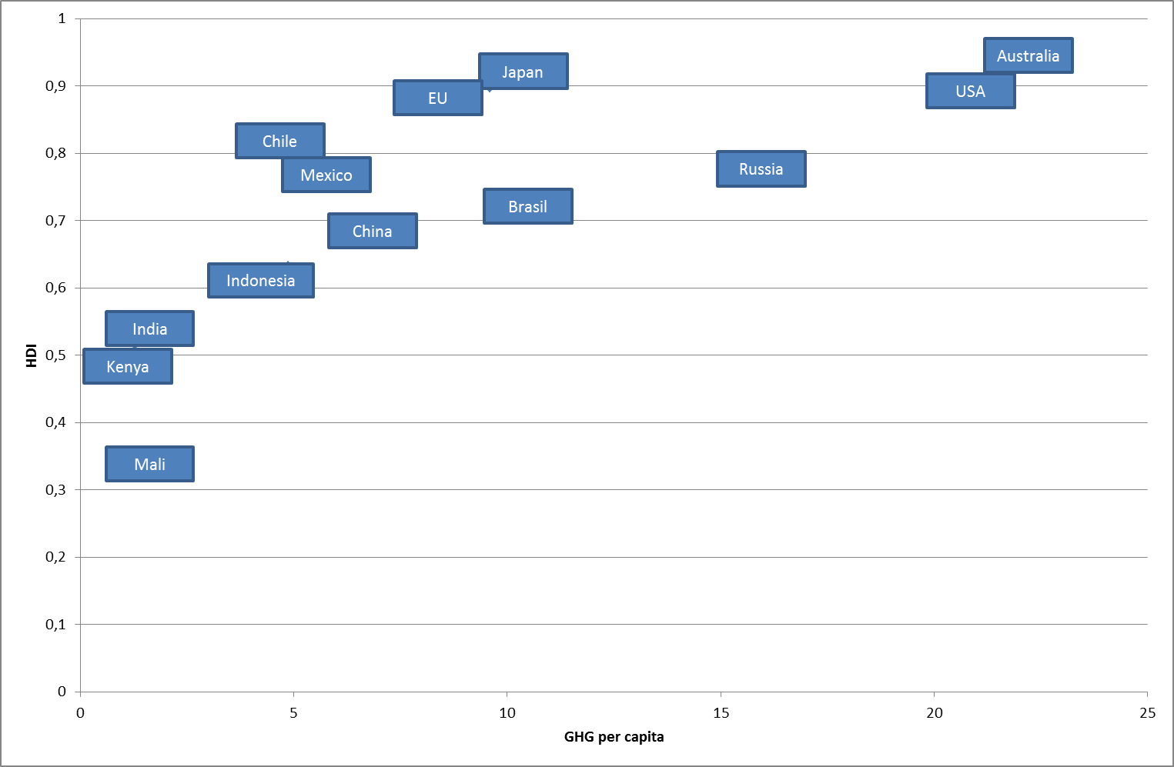
The climate nexus – reinventing prosperity
Climate friendly prosperity

Slide 4
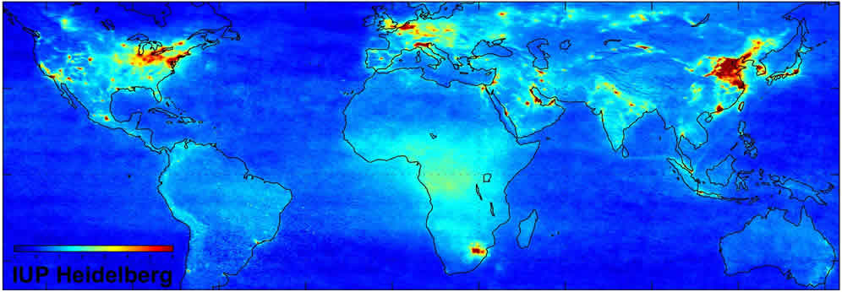
Adressing climate change – hopes and reasons to move
Climate action meets air quality problems in emerging economies
Nox Concentrations in the world, 2007
Nox pollutants come from incomplete and low quality fossil fuel combustion

Slide 5
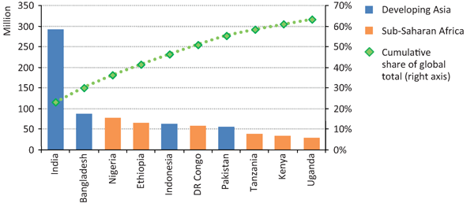
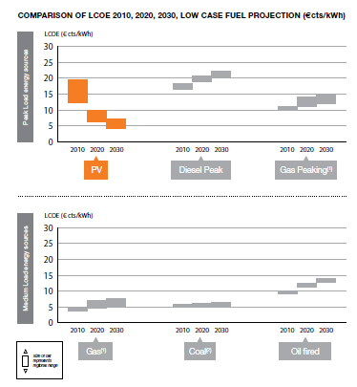
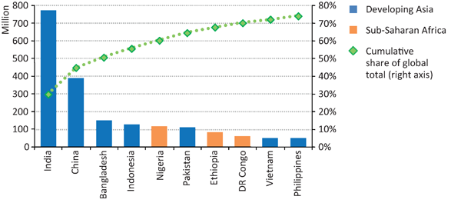
Energy access – the challenge of renewable deployment
Energy access should be adressed by renewables to avoid air quality problems
Renewables will be competitive in the next decades
Countries with the largest population without access to electricity, 2010
Countries with the largest population relying on traditional use of biomass for cooking, 2010

Slide 6
The keys to Paris 2015 – building blocks and principles
Commitments by all countries
To guarantee environmental integrity
Ambition
Differentiation of commitments
To take into account CBDR
Equity
Transparency, mesure, reporting and verification of emissions
To preserve the level playing field
Legal agreement
Technology transfer and diffusion
To boost the diffusion of green technologies
Incentives to Green economy
Greening of finance to re-orient the economy
Support for adaptation
To implement solidarity and adress impacts
Solidarity

Slide 7
A positive agenda to be harvested by Paris 2015
Local Authorities
Finance : innovative tools
Business / Sectorial agreements
Fueling the UNFCCC with green innovations
Solution oriented agenda
Sustainable Energy 4All
Insurance and Adaptation

Slide 8
The next steps toward Paris
2014
Year of ambition
2015
Year of solutions
Review of ambition
Positive agenda :
Initiative by non govermental actors
Mitigation commit-ments
UNSG summit
Ambition by leaders and Heads of State
Final discussion under UNFCCC
COP in Lima :
First draft of the agreement
Final agreement in Paris

