Slide 1
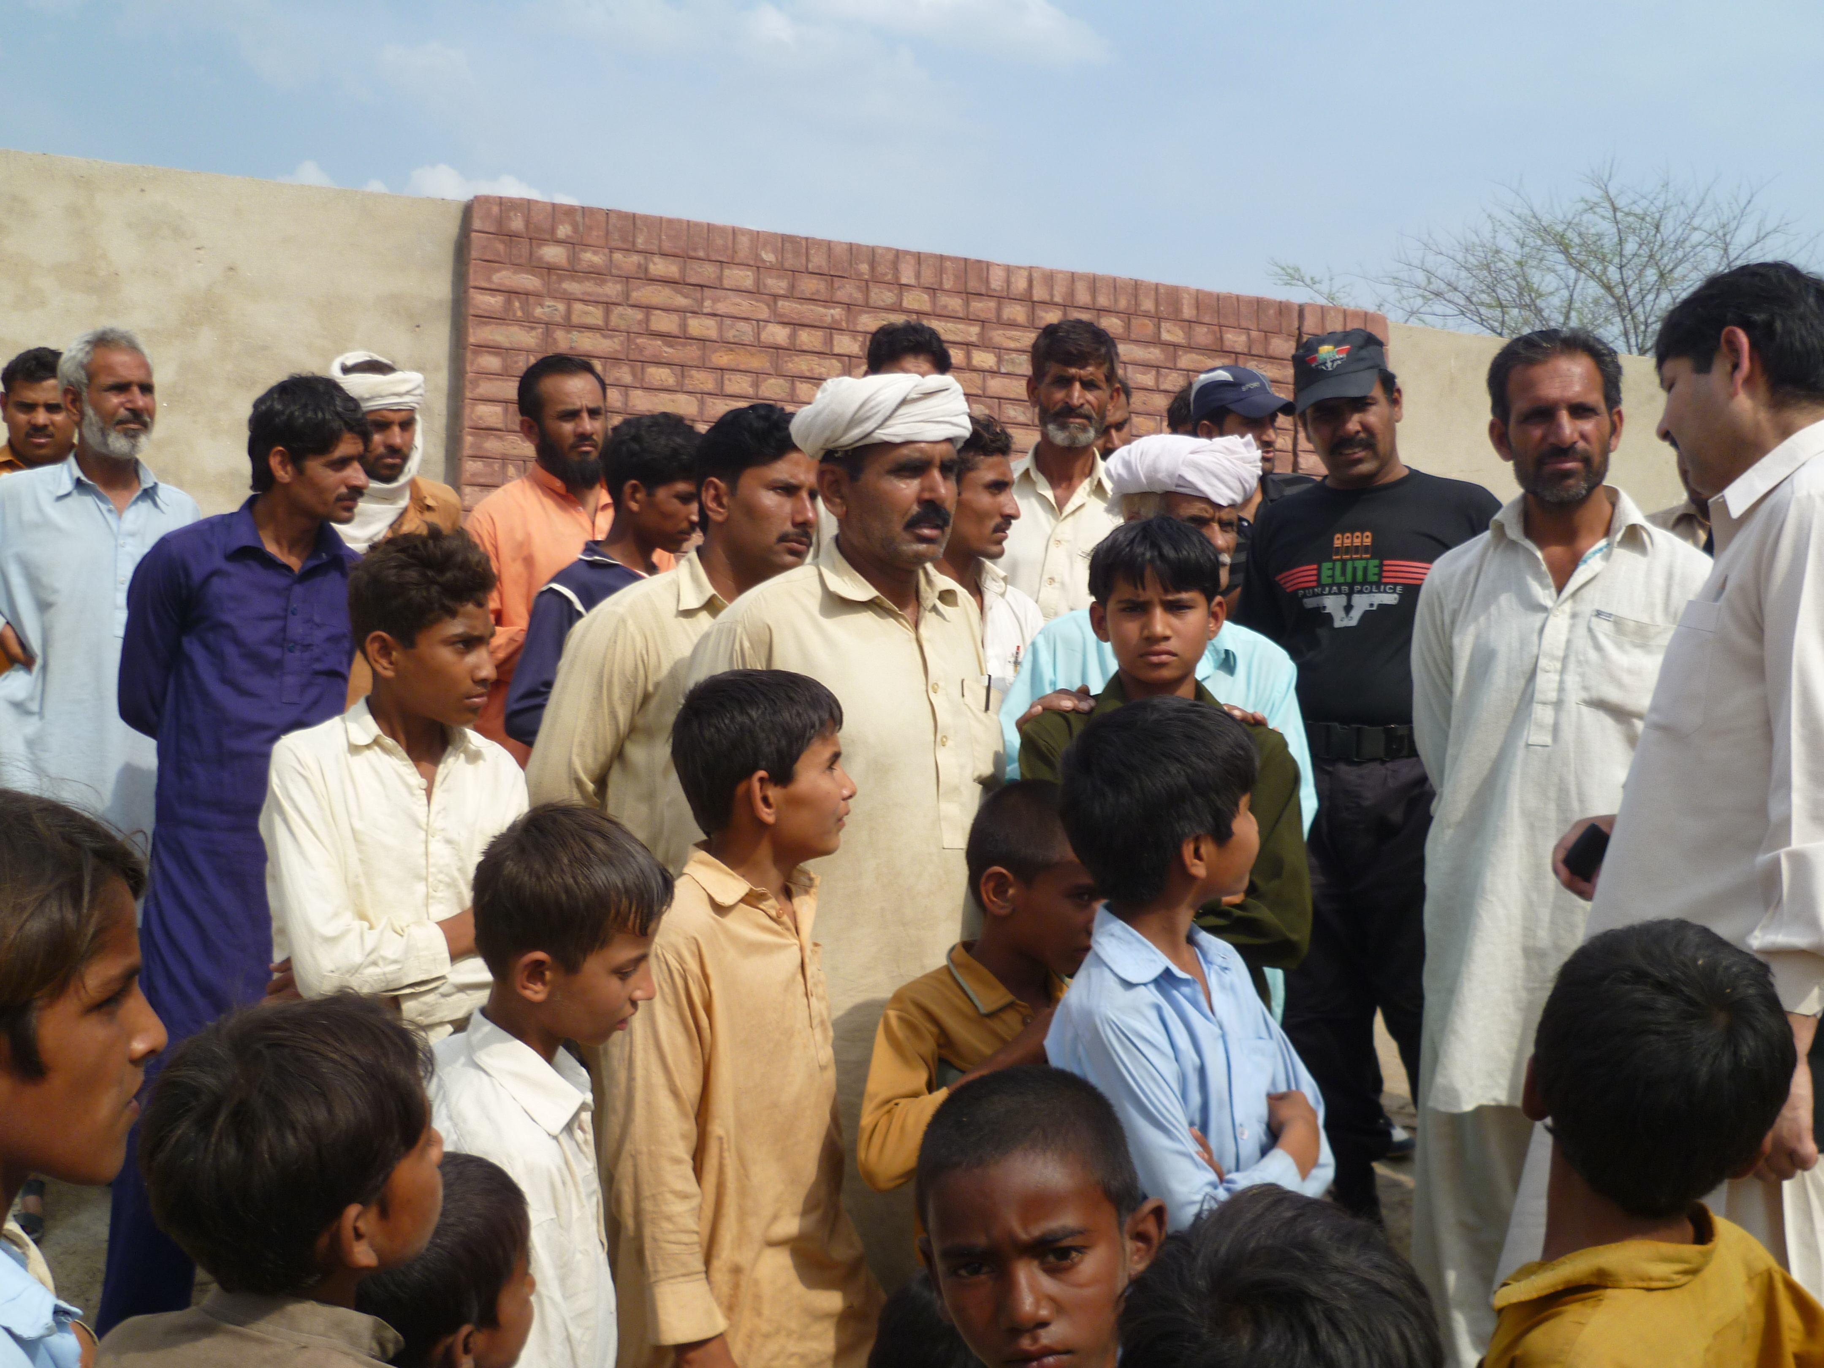
The Good News from Pakistan
SIR MICHAEL BARBER
Brookings Institution
6 June 2013

Slide 2
The Origins

Slide 3
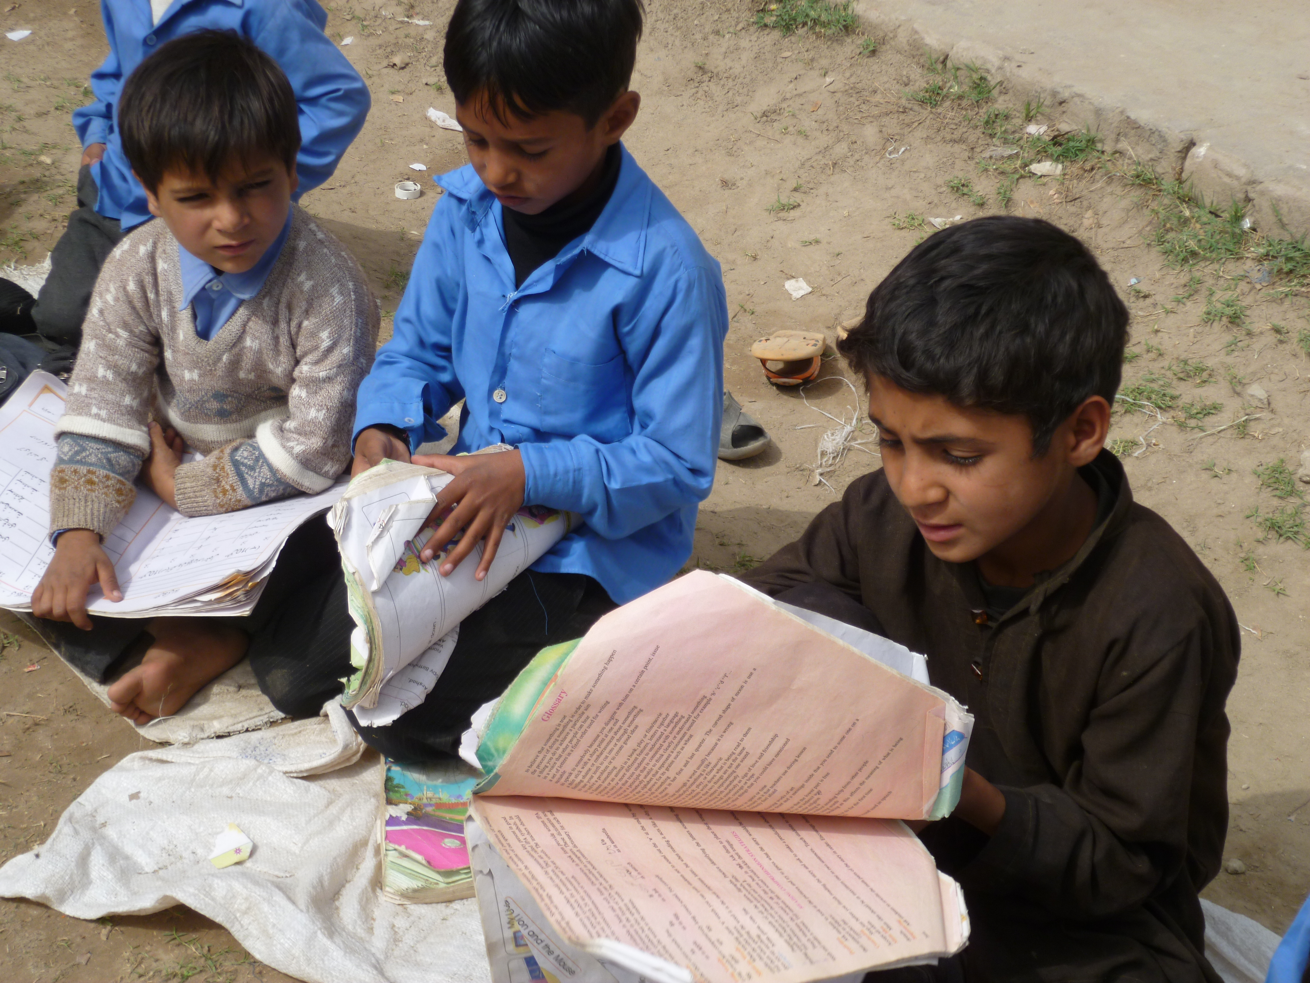

Slide 5
“I am of the opinion that the boldest measures are the safest”
Lord Nelson on the eve of the Battle of Copenhagen

Slide 6
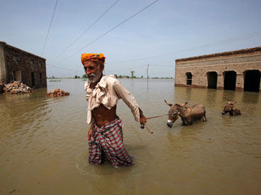

Slide 7
Did the flood make your schools better?
Michael Barber, to the Pakistani officials

Slide 8
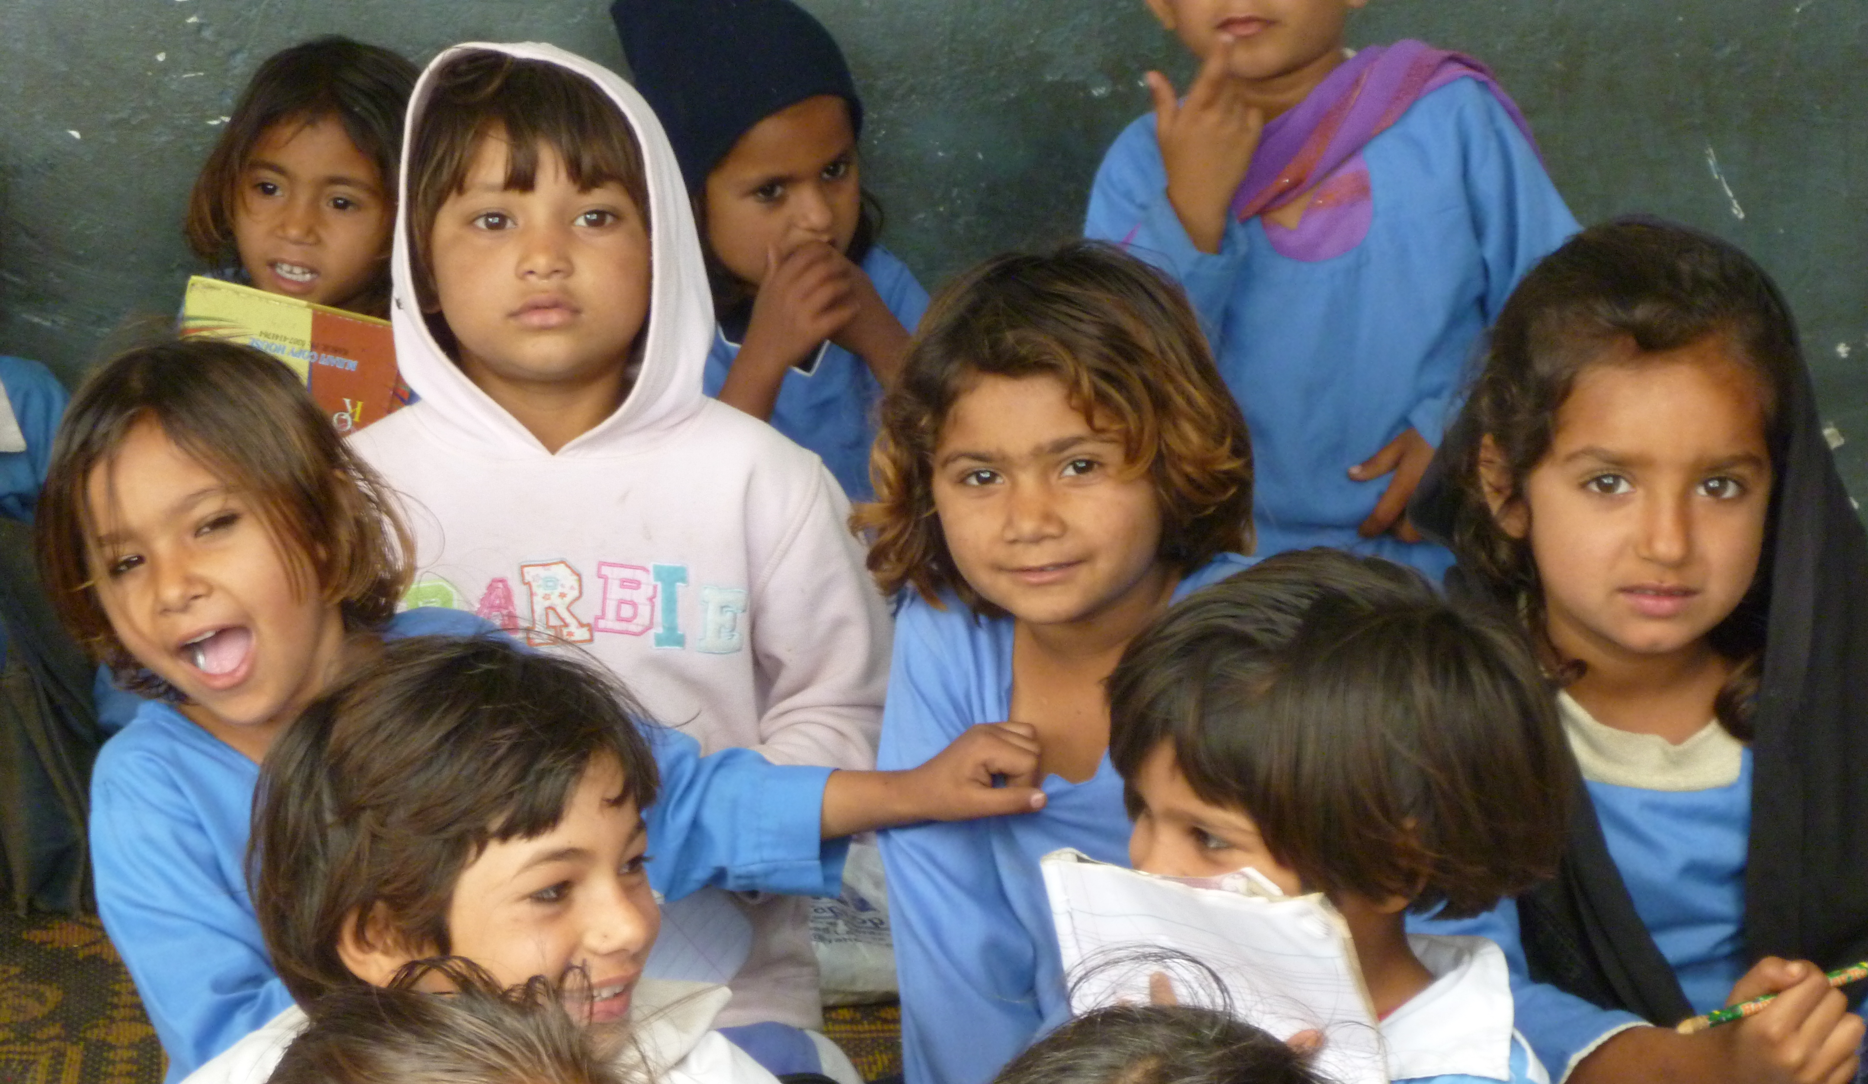
The Elements

Slide 9
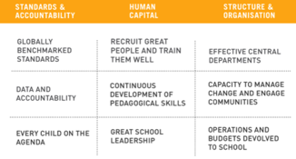
Elements of the roadmap
Punjab Education Foundation
Media campaign
Innovation Fund
Data and targets
District administration
Teacher quality
The enrolment drive
Additional supporting programs

Slide 10
We have pain in every bone in our bodies from working so hard, but want the Roadmap to continue because... it is nation-building.
An Executive District Officer (EDO)

Slide 11
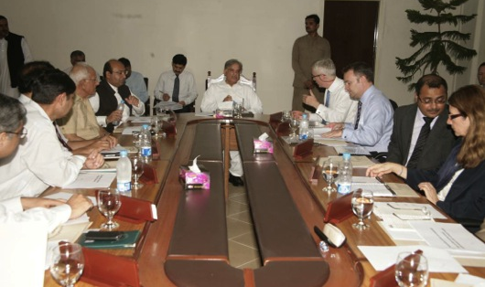
The Routines

Slide 12
Government is driven by crises and events but it’s routines that deliver results.
Sir Michael Barber, Instruction to Deliver

Slide 13
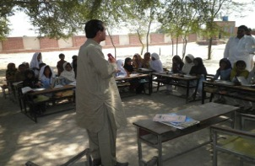
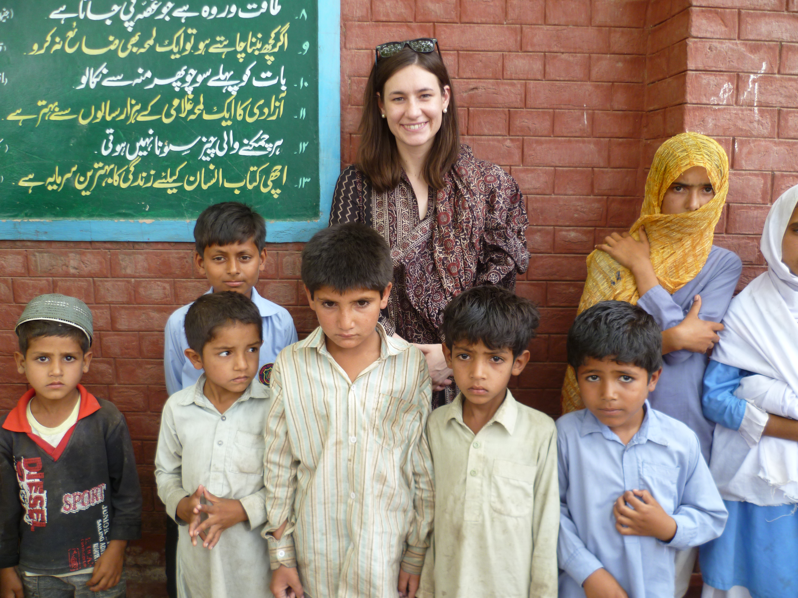
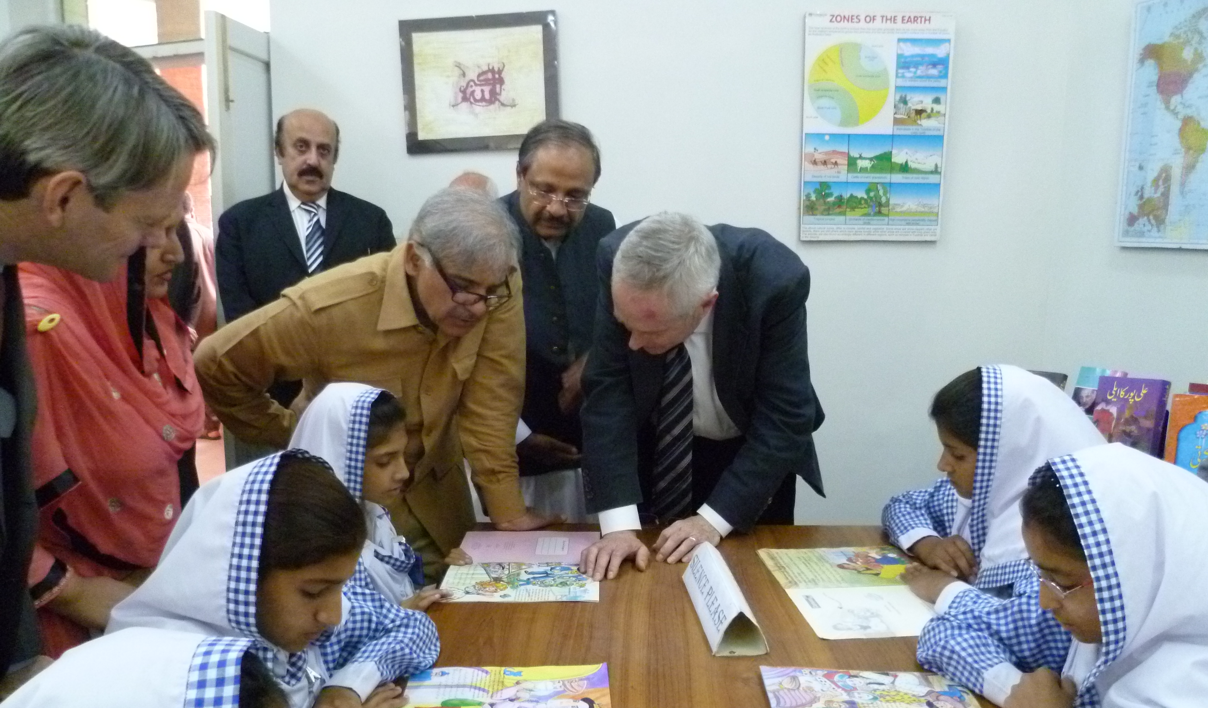
The Routines
Leadership Commitment
The Team on the Ground
Reviewing Roadmap Actions
The Stocktake
Absolute Discipline

Slide 14
5 Key Questions for Delivery
1. What are you trying to do?
Clear priorities
Specific, measurable goals
2. How are you trying to do it?
Clear, practical plans which are used regularly and updated
3. How, at any given moment, will you know whether you are on track?
Good, steady, close to real-time data on key indicators
Monitoring routines (such as stocktake meetings) with all key players involved
4. If you are not on track, what are you going to do about it?
Agreed actions, followed up, tested in practice and refined if necessary
Always try something. Never neglect a problem once identified
5. Can we help?
Constant ambition, refusal to give up
Focus on the goals, no distractions
Maintaining the routines
Analysis and problem-solving where required
Bringing to bear lessons from elsewhere

Slide 15
Reliable monthly data on progress
Notes:
15

Slide 16
Reliable monthly dashboards Priority 4: Expand the impact of PEF - actions have been updated to reflect current activities
On target
Off target
Actions
Action by
Timeline
32
Ensure timely release of funds and complete budgetary support to PEF to meet needs of all programs (FAS, EVS, and NSP) and related textbook, HR and administrative expenses
Secretary Finance
Continuous
33
Align on and adhere to principles to work together, ensuring that PEF has sufficient funds for its operations
Secretary Finance, Chairman PEF
15 May 2012
34
Ensure on time implementation of 2012-13 EVS expansion of 10k vouchers
Chairman PEF, Secretary Finance/DFID
Continuous
35
Implement appropriate anti-corruption processes including independent review of anti-corruption plan
Chairman PEF
Continuous
36
Develop student information systems to capture and record data across all programs
Chairman PEF
Continuous
37
Expand monitoring and evaluation capabilities
Chairman PEF
Continuous
38
Conduct quality assurance testing
Chairman PEF,
DFID/Sec Finance
Continuous
39
Build capacity to meet current and future needs of PEF’s programs
Chairman PEF, DFID
Continuous

Slide 17
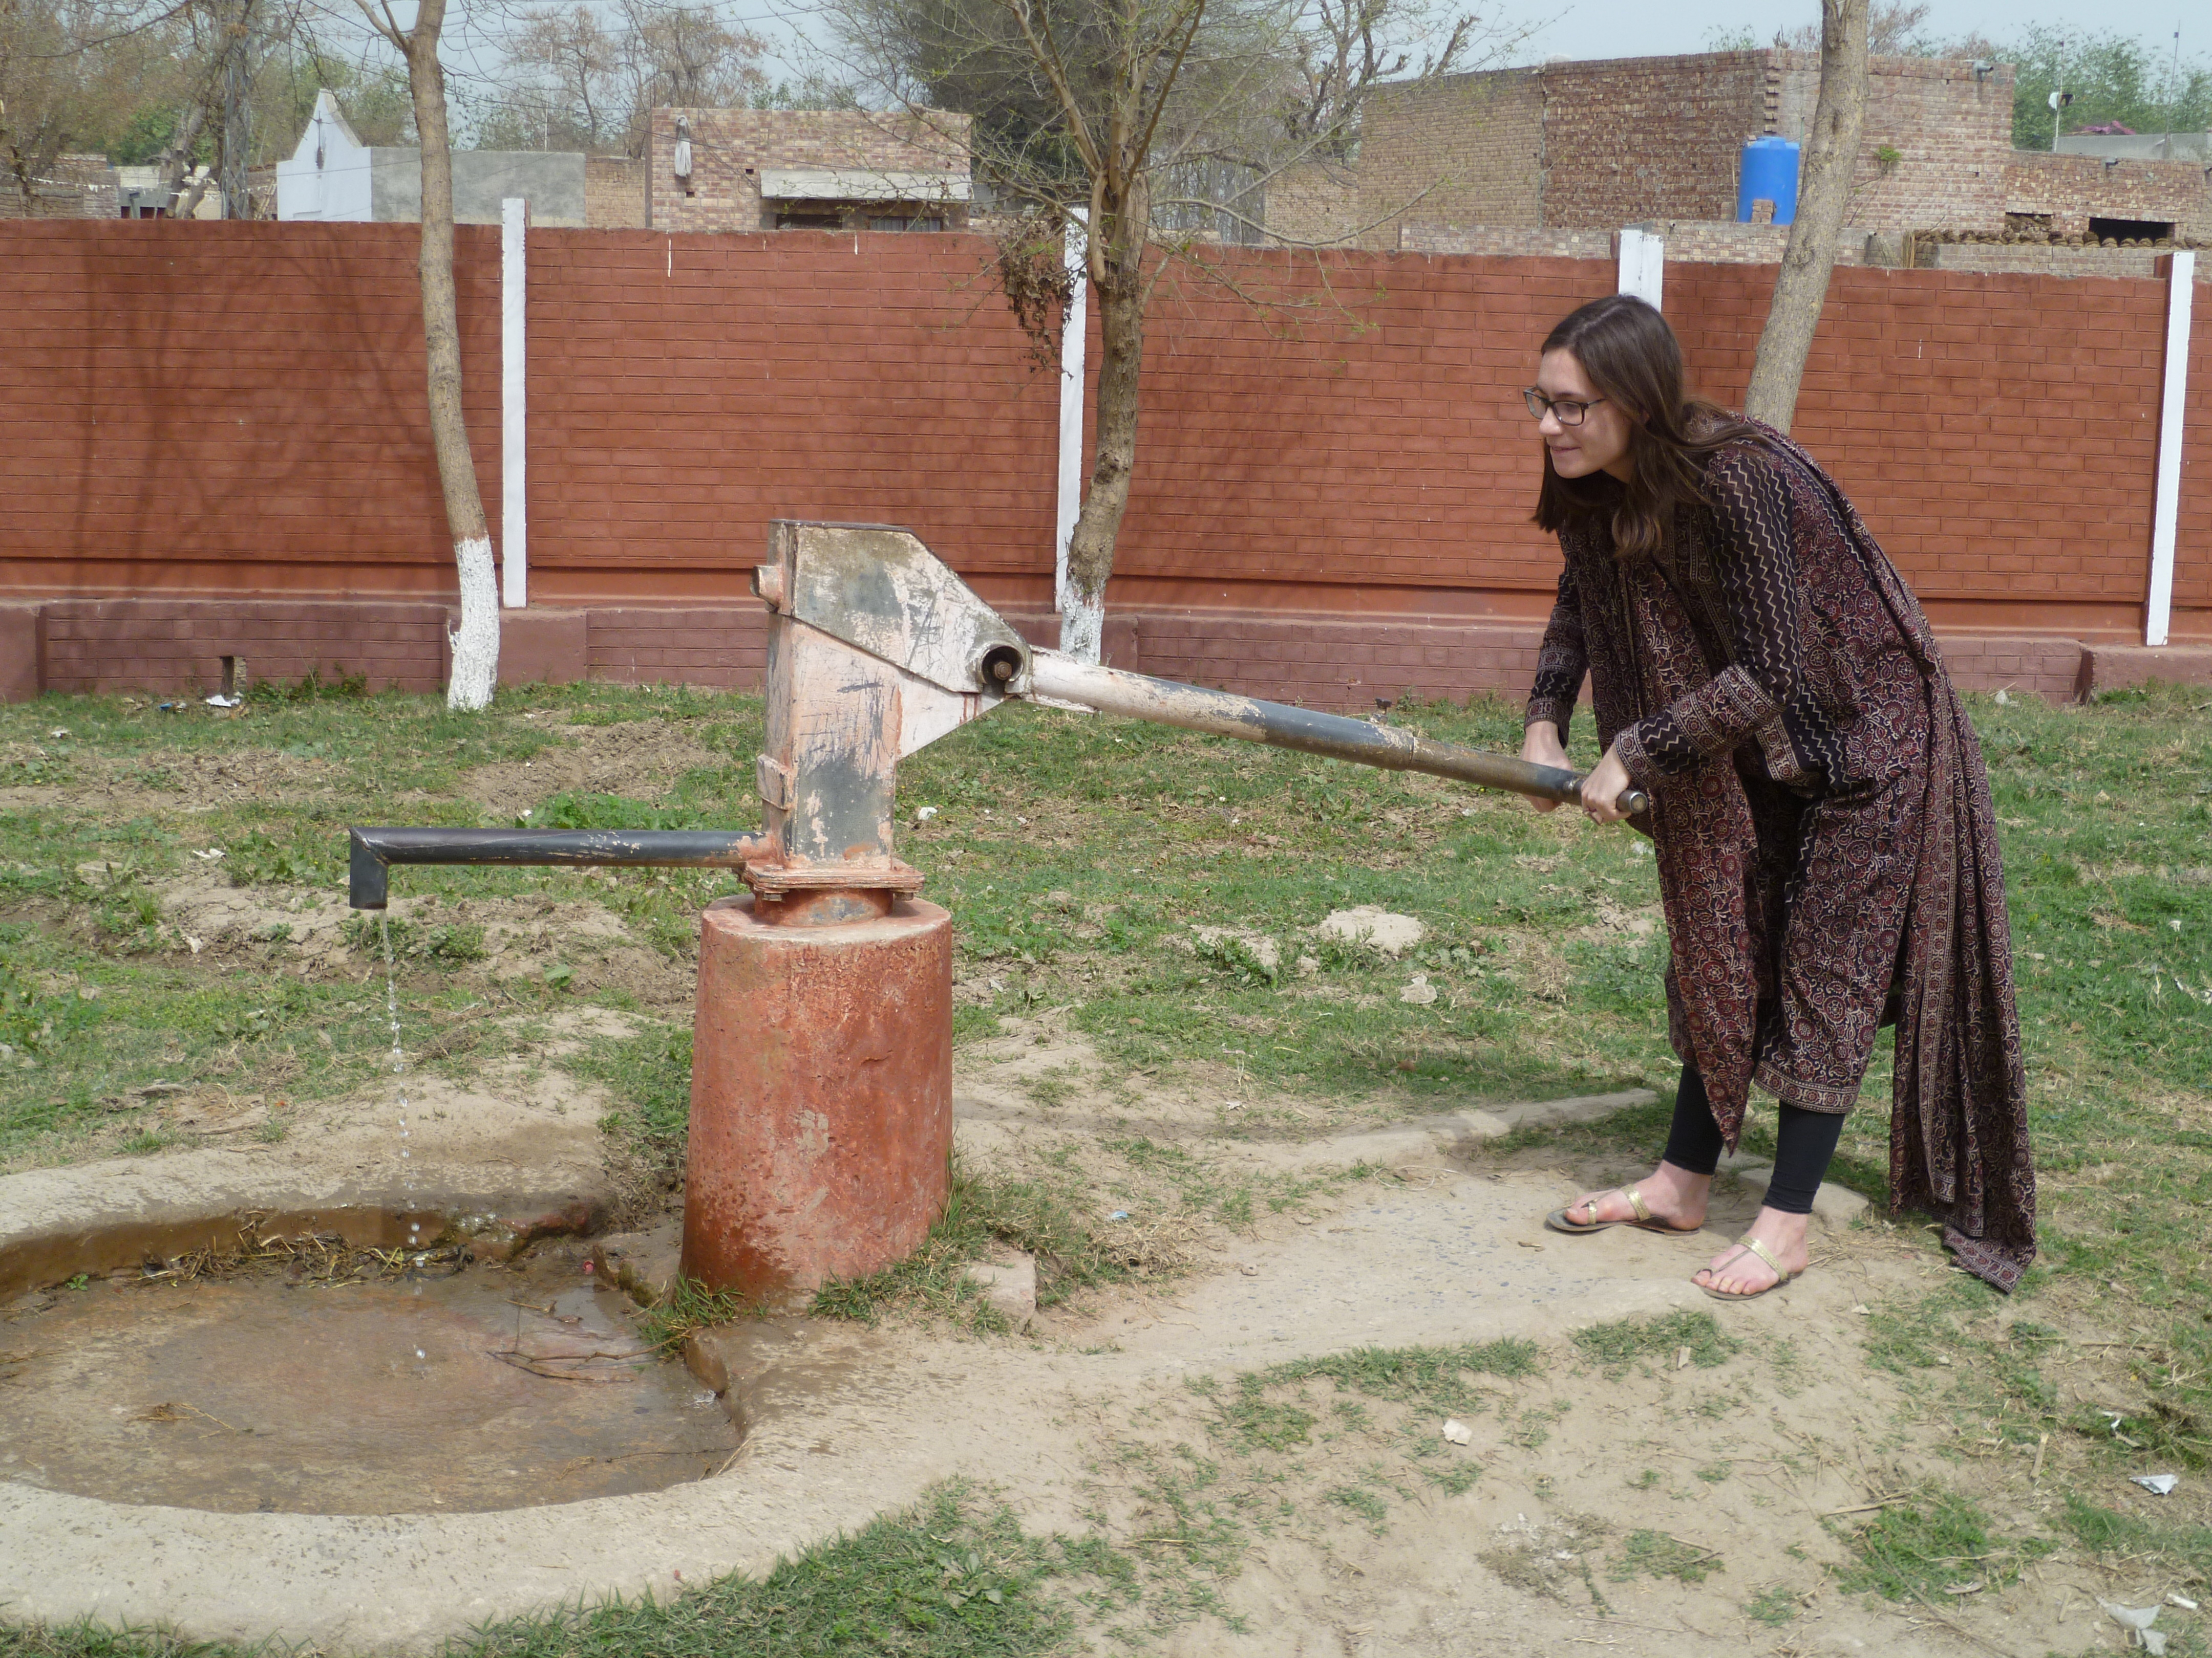

Slide 18
The Results

Slide 19
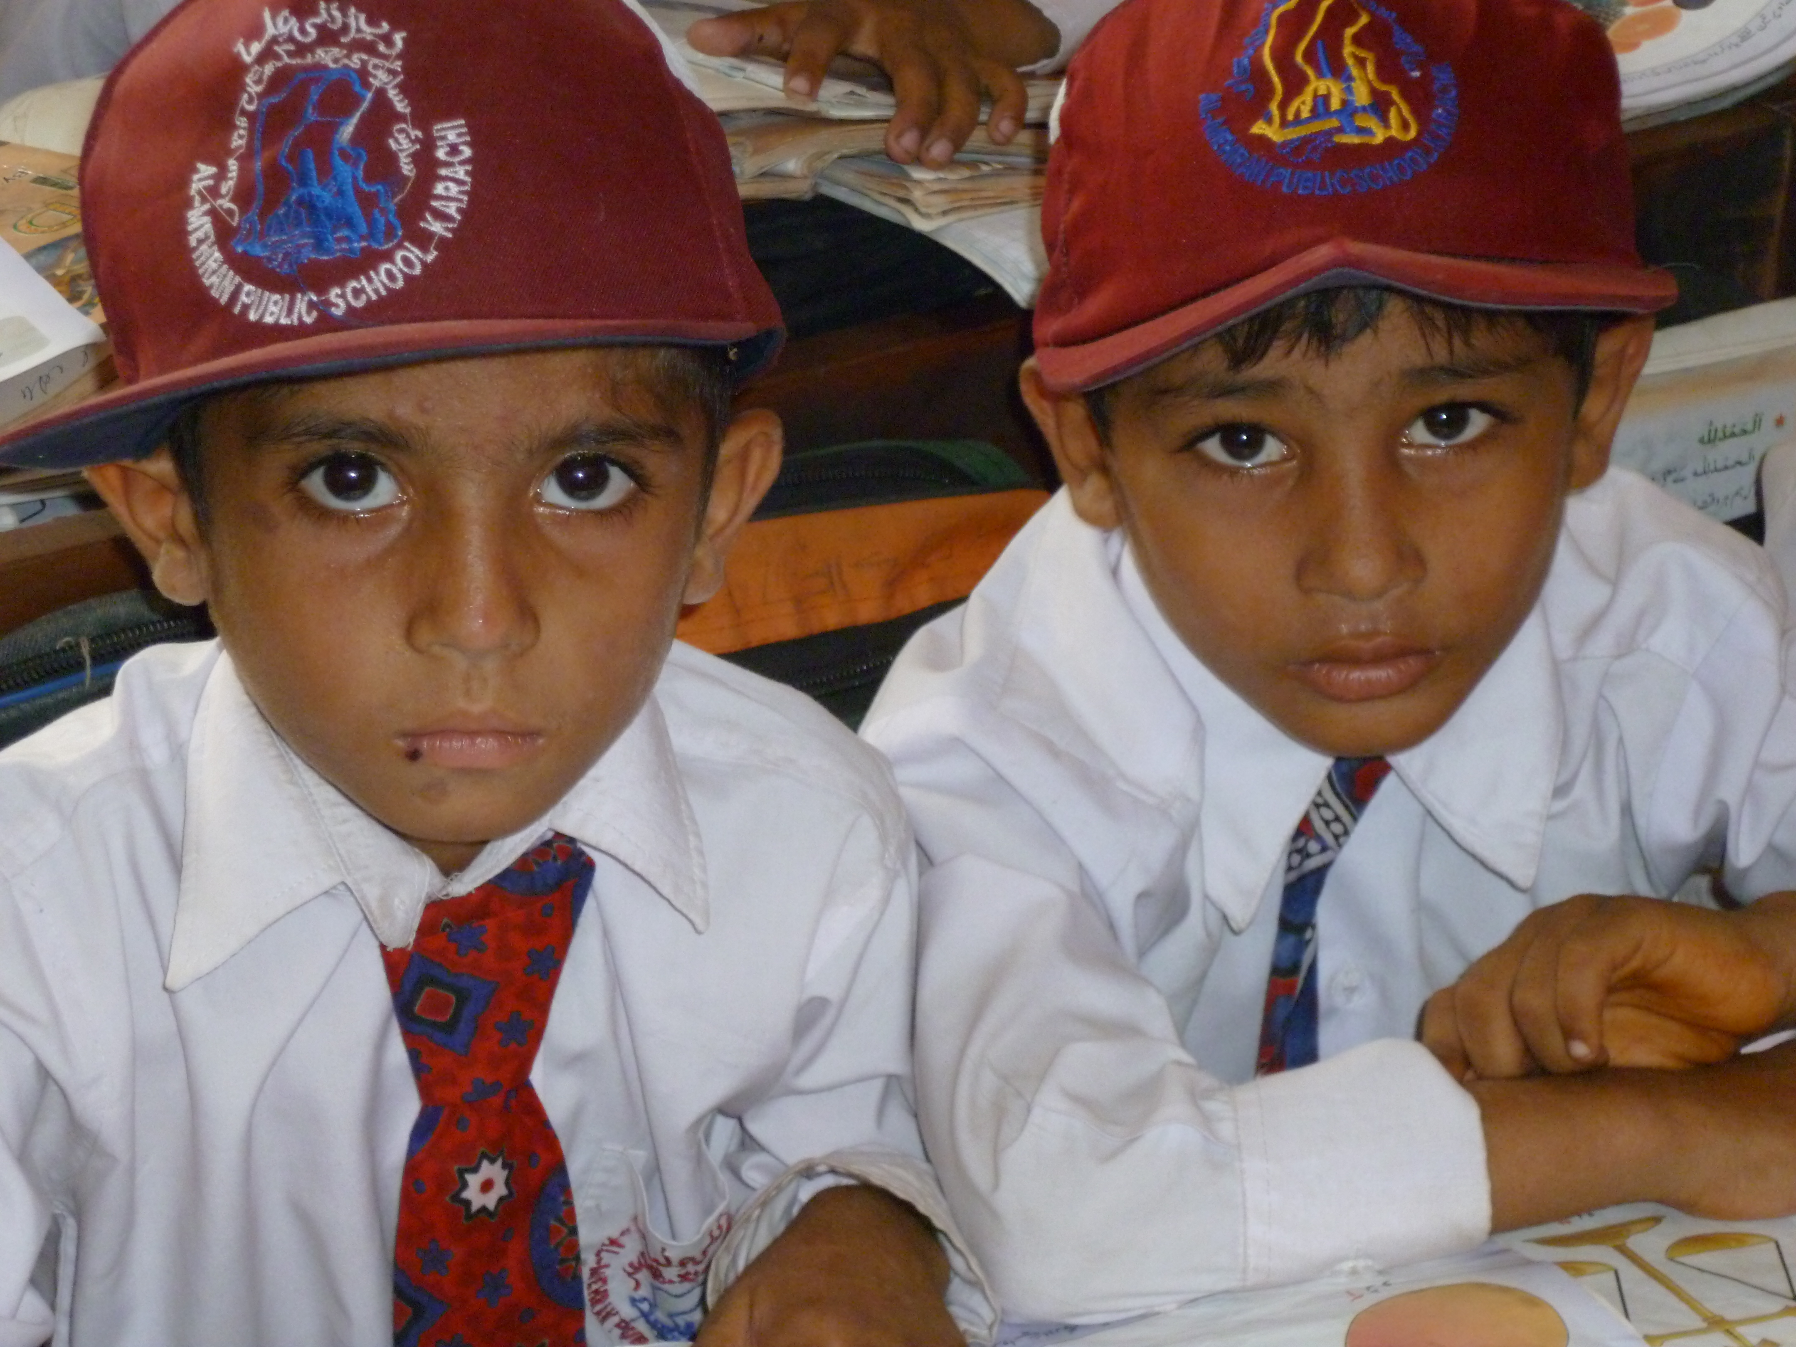
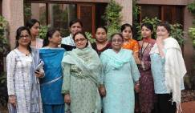
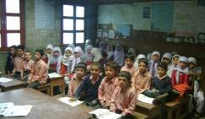
A new day is dawning on education in Punjab
Higher enrolment and student attendance
More teachers attending than ever before
More schools with better basic facilities
Stronger administration focusing on improving quality

Slide 20
The education system is now being effectively managed
District administration visits
% of schools visited by district administrators
Aug.
2011
Oct.
2011
Nov. 2011
Dec. 2011
Jan.
2012
Feb.
2012
Mar.
2012
Apr.
2012
Aug.
2012
Sep.
2012
Oct.
2012
Nov.
2012
Target:
90%
SOURCE: PMIU
20
Notes:
20
20

Slide 21
Approaching 1,500,000 extra children age 5-16 enrolled in school since 2011

Slide 22
The biggest challenge remains in rural areas and among girls
Enrolment for 5-9 year-olds
Northern Districts
Central Districts
Southern Districts
Urban
Rural
Urban
Rural
Urban
Rural
95%
96%
93%
92%
76%
Male
88%
76%
95%
96%
92%
91%
67%
Female
82%
SOURCE: Nielsen Household Survey December 2012
22

Slide 23
In 2013, our focus will need to be on the South
Enrolment of 5-9 year-olds, Percent
Chakwal
Above 90%
80-84%
Jehlum
Attock
85-90%
Below 80%
Rawalpindi
Sialkot
Gujrat
Narowal
Gujranwala
Attock
Rawalpindi
Mandi Bahauddin
Hafizabad
Chakwal
Jhelum
Lahore
Mianwali
Gujrat
Sargodha
Toba Tek Singh
M.B. Din
Sialkot
Faisalabad
Khushab
Sargodha
Narowal
Okara
Hafizabad
Gujranwala
Mianwali
Bhakkar
Shekhupura
Nankana Sahib
Chiniot
Nankana
Sahib
Kasur
Jhang
Faisalabad
Lahore
Khushab
Jhang
Layyah
T.T. Singh
Kasur
Bahawalnagar
Okara
Sheikhupura
Muzaff-
argarh
Sahiwal
Layyah
D.G. Khan
Khanewal
Pakpattan
Sahiwal
Chiniot
Vehari
Multan
Lodhran
Bhakkar
Multan
Bahawalnagar
Khanewal
Lodhran
Rajanpur
Vehari
Pakpattan
Bahawalpur
Bahawalpur
Rahimyar Khan
Muzaffargarh
Dera Ghazi Khan
Rahim Yar Khan
Rajanpur
SOURCE: Nielsen Household Survey December 2012
23

Slide 24
Student attendance has reached a new high, above the 2013 target
% of students attending school each day
Target trajectory
92.1
89.3
87.9
88.4
87.1
87.3
86.7
86.8
86.3
85.4
82.8
83.3
83.2
79.0
Baseline
Sep. 2011
Oct. 2011
Nov. 2011
Dec. 2011
Jan. 2012
Feb. 2012
Mar. 2012
Apr. 2012
May 2012
Sep.
2012
Oct.
2012
Nov.
2012
Dec.
2012
March 2013 target:
90%
SOURCE: PMIU
24
Notes:
24
24

Slide 25
A further 1,000,000 children attending school everyday since the Roadmap began

Slide 26
32 districts are on or above trajectory
1. STUDENT ATTENDANCE
On or above trajectory
Close to trajectory
Dec 2012 – student attendance vs. trajectories
Made some progress not
close to trajectory
District
Performance
Target
Delta
Green
Significantly off track
Nankana Sahib
92.0
86.3
Bahawalnagar
94.7
90
Gujrat
94.5
90
Jhelum
94.4
90
Sargodha
94.4
90
Faisalabad
94.4
90
Attock
Pakpattan
90.4
86.2
Rawalpindi
T.T. Singh
95.1
90.9
D.G. Khan
85.5
81.4
Chakwal
Jhelum
Jhang
93.9
90
Mianwali
Gujrat
Rawalpindi
93.9
90
M.B
. Din
Mandi Baha Ud Din
93.7
90
Sargodha
Sialkot
Sheikhupura
93.6
90
Khushab
Hafizabad
Gujranwala
Narowal
Lahore
93.4
90
Khushab
93.2
90
Bhakkar
Chiniot
Sheikhupura
Okara
94.8
92
Nankana
Sahib
Lahore
Multan
92.5
89.7
Jhang
Faisalabad
Sialkot
92.6
90
Layyah
T.T
Kasur
Khanewal
93.0
90.4
Singh
Attock
92.4
90
Muzaff-
argarh
Okara
Bahawalpur
92.3
90.2
D.G. Khan
Khanewal
Sahiwal
Pakpattan
Chakwal
93.8
91.8
Chiniot
91.8
90
Vehari
Vehari
91.7
90
Lodhran
Hafizabad
91.7
90
Multan
Lodhran
91.7
90
Bahawalnagar
Sahiwal
92.3
90.7
Rajanpur
Muzaffargarh
88.3
87.1
Kasur
91.2
90
Bahawalpur
Rahimyar Khan
88.5
87.6
Narowal
89.7
88.9
Rahimyar Khan
Mianwali
89.7
89.4
Amber Green
Gujranwala
89.4
90
Layyah
88.6
89.3
Bhakkar
89.1
90
Amber Red
Rajanpur
78.5
84.3
SOURCE: PMIU
26
Notes:
26
26

Slide 27
Facilities is at a new high, 1.1% short of the 2013 target
Availability and functioning of facilities
% functioning electricity, drinking water, toilet and boundary walls
Target trajectory
89.7
90.4
90.9
89.4
87.0
87.8
85.2
86.1
83.5
84.4
81.0
78.2
75.1
68.9
Base
line
Sep. 2011
Oct. 2011
Nov. 2011
Dec. 2011
Jan. 2012
Feb. 2012
Mar. 2012
Apr. 2012
May 2012
Sept. 2012
Oct.
2012
Nov.
2012
Dec.
2012
March 2013 target:
92%
SOURCE: PMIU
27
Notes:
27
27

Slide 28
Around 3,000,000 children have benefited from these additional facilities

Slide 29
Teacher presence is at a new high, above the 2013 target
Teacher presence
% of teachers present at time of inspection
Target trajectory
92.1
90.2
88.3
88.2
88.6
87.3
87.5
87.2
86.5
86.0
84.7
84.7
1.1
83.2
91.0
89.2
80.7
Baseline
Sep. 2011
Oct. 2011
Nov. 2011
Dec. 2011
Jan. 2012
Feb. 2012
Mar. 2012
Apr. 2012
May 2012
Sep.
2012
Oct.
2012
Nov.
2012
Dec.
2012
March 2013 target:
90%
SOURCE: PMIU
29
Notes:
29
29

Slide 30
37,000 extra teachers attend school every day

Slide 31
The teacher quality pilots had a major impact in one month
Percentage of teachers in sample who were …
… using a lesson plan
… teaching using activities
… asking questions to check learning
+27
+31
+39
Sept
Oct
Sept
Oct
Sept
Oct
NOTE: The above are just three of the twelve indicators used to evaluate and mentor teachers during the pilot

Slide 32
In April every child in Punjab will receive new textbooks in line with the 2006 national curriculum

Slide 33
The Roadmap has resulted in a large increase in the number of children from poor families receiving vouchers
Number of children receiving vouchers
‘000s

Slide 34
The Lessons

Slide 35
The twelve lessons of the Punjab Roadmap
To boldly go
The brutal facts
Never relent
Lesson 5: The conversation must be honest
Lesson 1: Be ambitious
Lesson 9: Persist
Lesson 6: Know what’s really happening
Lesson 10: Build a guiding coalition
Lesson 2: Set clear goals
Lesson 3: Prepare, plan and get on with it; you can refine it as you go
Lesson 7: Refine constantly but don’t compromise
Lesson 11: Focus on the change that’s needed…Work back from there to the money
Lesson 12: When all else fails in Pakistan, you can always talk about cricket
Lesson 4: Establish routines that work
Lesson 8: Create momentum

Slide 36
We must lay the groundwork for a new kind of knowledge, what some have called a ‘science of delivery’, that countries will use to meet the demands of their people
Jim Yong Kim, President of the World Bank

Slide 37
The Next Steps

Slide 38
The visionary leaders in countries such as Pakistan … want their province or country to succeed and ultimately to do so without any dependence on aid.

