Slide 1
From Enrollment to Learning Outcomes: What Does the Shift in the Education Agenda Mean for NEAs?
Technical Workshop on National Education Accounts (NEAs)
Jacques van der Gaag
January 25, 2013

Slide 2
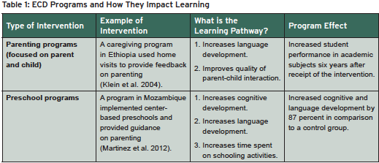

Slide 3
Implications for NEAs
Definition of education sector (or “learning sector”)
Include ECD programs and activities
Government data
Household data
(Community level data; local government)

Slide 5
Implication for NEAs
Level of detail of expenditures
All learning materials?
Textbooks by grade?
Level of detail of teacher salaries
Total payments?
Separate out bonus or other incentive payments?
Include expenditures on remedial education

