Slide 1
Africa’s great learning divide – inequality as barrier to progress in education
Kevin Watkins
Center for Universal Education | Brookings Institution
April 17, 2013

Slide 2
What’s at stake?
A basic human right
Shared prosperity and inclusive growth
Progress in health, nutrition and poverty reduction
Gender equity
Africa’s future

Slide 3
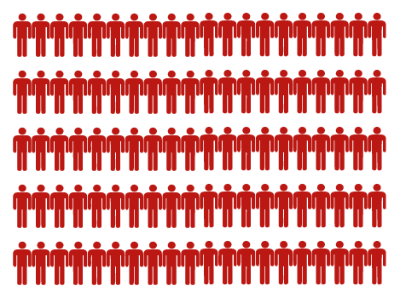
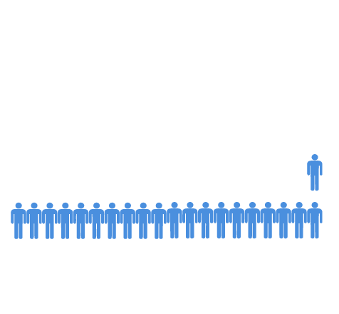
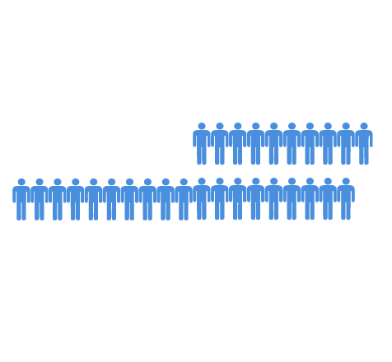
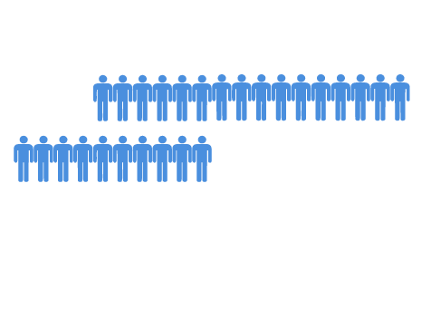
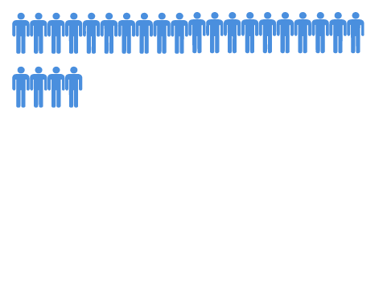
The primary school cohort – 127 mn
ANOTHER 33 MILLION DROP OUT
30 MILLION NEVER ENROLL
Notes:
Total primary school age population: 127 million (127,670,652)
Of which: 30 million never enroll (24% of total)
Only 97 million (76% of total) enroll in primary school
Only 64 million (66%) of those who enroll in primary school make it to the last grade.
63 million (49.6 % of total) do not complete primary school- in other words 1 in 2 do not make it through school

Slide 4
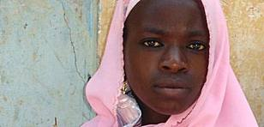
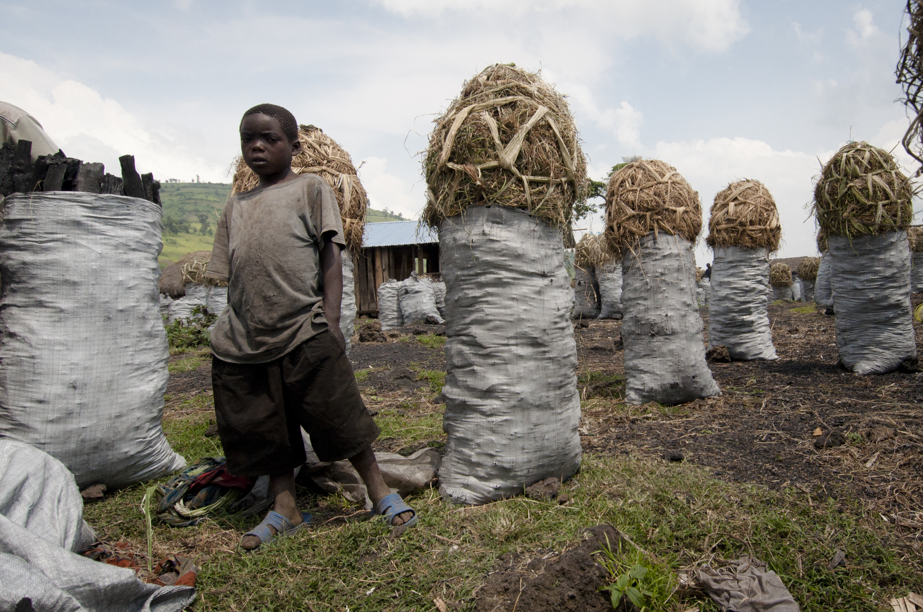
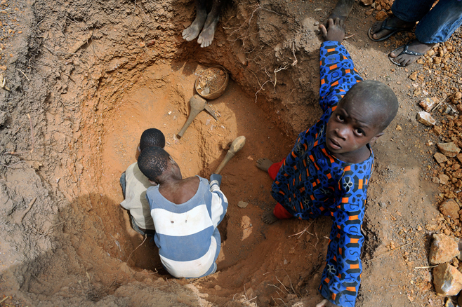
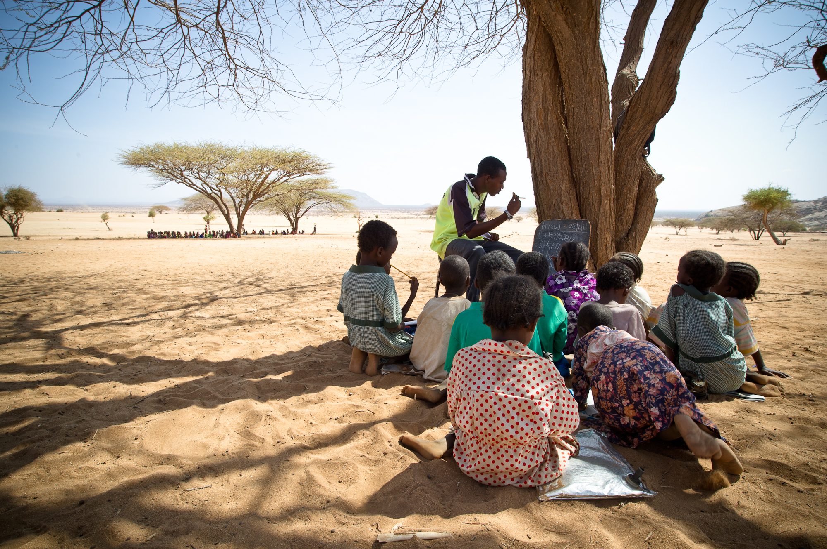
Why children aren’t in school
Photo credit: ILO, GMR, Office of UN Special Envoy for Global Education Gordon Brown
Notes:
1. Child bride- Nigeria
2. Child Labor/Urban slums – your story from Bangladesh Kevin
3. Conflict – your story from DRC
4. Rural areas- Kenya

Slide 5
Interactive inequality – wealth, gender and location
The case of Nigeria
14
Ukraine
12
Cuba
10 years
10.3 years
9.7 years
Rural
Rich, rural boys
10
Richest 20%
Rich, urban boys
Bolivia
Urban
Rich, rural girls
Indonesia
Boys
8
Girls
Average number of years of schooling
(Age group 15-17 years)
Honduras
Nigeria
Cameroon
Urban
Poor, urban boys
6
6.7 years
6.4 years
Bangladesh
4
Education poverty
Poorest 20%
3.5 years
Rural
Chad
3.3 years
Poor, rural girls
2
2.6 years
Extreme education poverty
Source: UNESCO GMR
C. A. R.
Rural Hausa
Poor, rural Hausa girls
0
0.5 years
0.3 years

Slide 6
Getting through school without learning
ONLY 27 MILLION CHILDREN LEARN
Notes:
Only 27 million (21% of total and 28% of total enrolled) of those who stay in school learn

Slide 7
Wealth Gap in Learning
Malawi 2007: Reaching minimum learning standards
AVG: 52%
•
National Avg. 0%
100%
GIRLS: 47%
BOYS: 55%
Gender
⊕
⊕
0%
100%
RURAL: 49%
URBAN: 63%
Region
0%
⊕
⊕
100%
POOR: 48%
WEALTHY: 59%
Income
⊕
⊕
0%
100%

