Slide 1
Presented to: Presented by:
NEA Technical Committee Meeting Igor Kheyfets
Center for Universal Education at Brookings The World Bank

Slide 2
Overview
What is BOOST?
How does BOOST work?
How can BOOST contribute to the development of National Education Accounts (NEAs)?

Slide 3
What is BOOST?
A new way of thinking about, collecting, analyzing and sharing public expenditure data
An initiative (started at the World Bank in 2009) aimed at improving the quality of public expenditure analysis by linking spending to results

Slide 4
Objective of the BOOST initiative
To improve the quality and efficiency of service delivery through more transparency, more insightful analysis of spending and outcomes, and more involvement of civil society in monitoring of spending and results
Create easy-to-use databases of public spending
Train counterparts and civil society in how to use such databases
Merge detailed expenditure data with data on sector outcomes
Show the type of analytical work that can be done with such data

Slide 5
How does BOOST work?
World Bank (WB) team engages the country’s Ministry of Finance (MOF) in a discussion of how detailed data on public spending can be used to enhance the quality and depth of policy analysis and policymaking
MOF shares with the WB detailed public expenditure data from the country’s Treasury system
WB team learns the country’s budget structure and compiles raw Treasury data into a comprehensive database, labeled with the MOF’s own budget classification codes

Slide 6
How does BOOST work? (cont’d)
WB team ensures that budget and expenditure amounts in the BOOST database are in line with published official reports
WB team presents to MOF a user-friendly BOOST database with an Excel PivotTable interface and a User’s Manual
MOF endorses BOOST as being in line with official figures
WB team works with government counterparts to build capacity in utilizing BOOST for expenditure analysis and encourage public disclosure of BOOST data

Slide 7
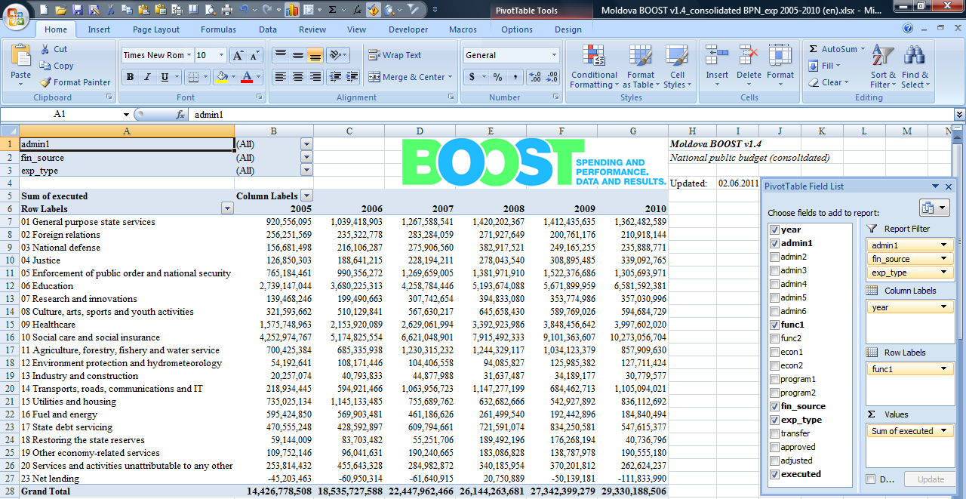
At the core of BOOST is a large Excel dataset with an easy-to-use PivotTable interface

Slide 8
How can BOOST contribute to National Education Accounts (NEAs)?

Slide 9
How can BOOST contribute to National Education Accounts (NEAs)?
Always covered by BOOST
Sometimes* covered by BOOST
* Donor financing of education will be covered by BOOST if these funds flow through the public budget;
* Private Schools’ financing will be covered by BOOST if these schools are funded in full or in part through the public budget;
* Learning Outcomes will be covered by BOOST if such data are collected and compiled in the BOOST education sector module.

Slide 10
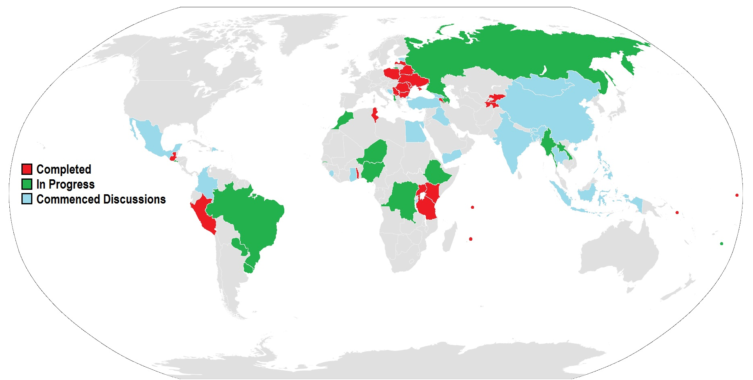
BOOSTs have been constructed or are under development in 30+ countries

Slide 11
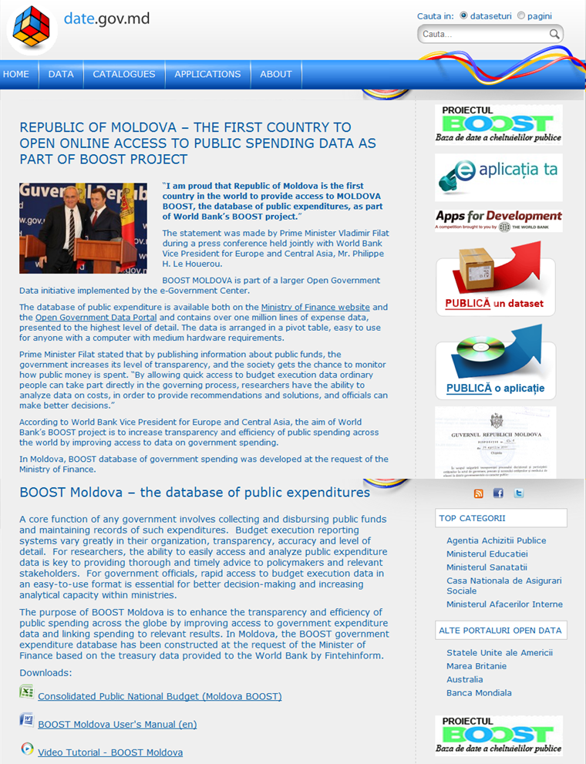
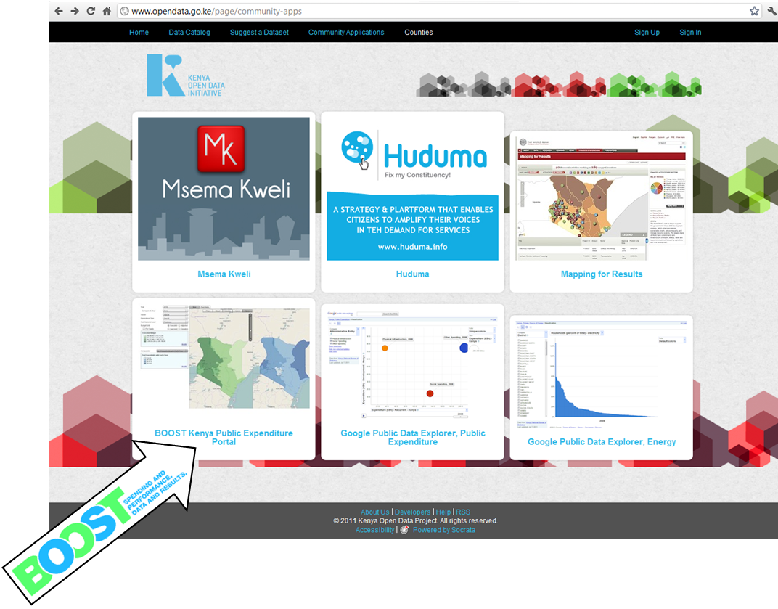
Two countries – Moldova and Kenya – have made their BOOSTs public

Slide 12
Thank You We look forward to hearing your feedback Igor ikheyfets@worldbank.org Lars lsondergaard@worldbank.org Dino dmerotto@worldbank.org Massimo mmastruzzi@worldbank.org

