Slide 1
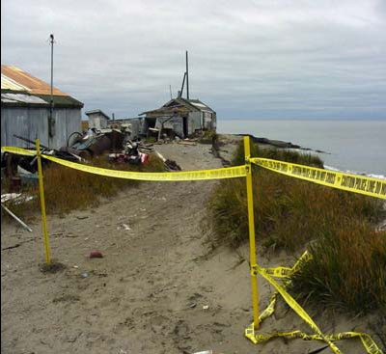
Climate Change in Alaska
Temperatures have increased an average of 3.5 Celsius in winter since 1950s. Permafrost is melting and decrease in arctic sea ice.
Accelerated rates of erosion.

Slide 2
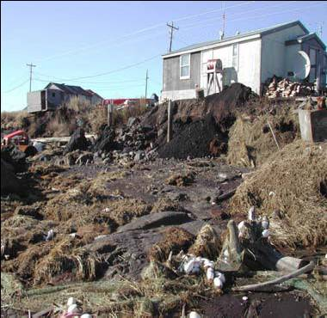
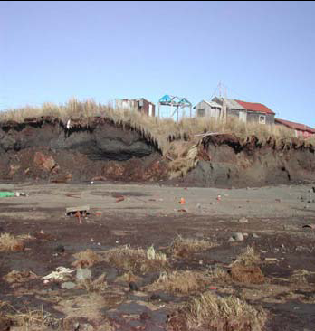
Photos: Frank Myoumick-Kawerak
2003 US Government Accountability Office (GAO) found 3 communities seeking to relocate in Alaska and 184 other communities are being affected by flooding and erosion
2009 US GAO report found 31 imminently threatened and 12 seeking to relocate.

Slide 3
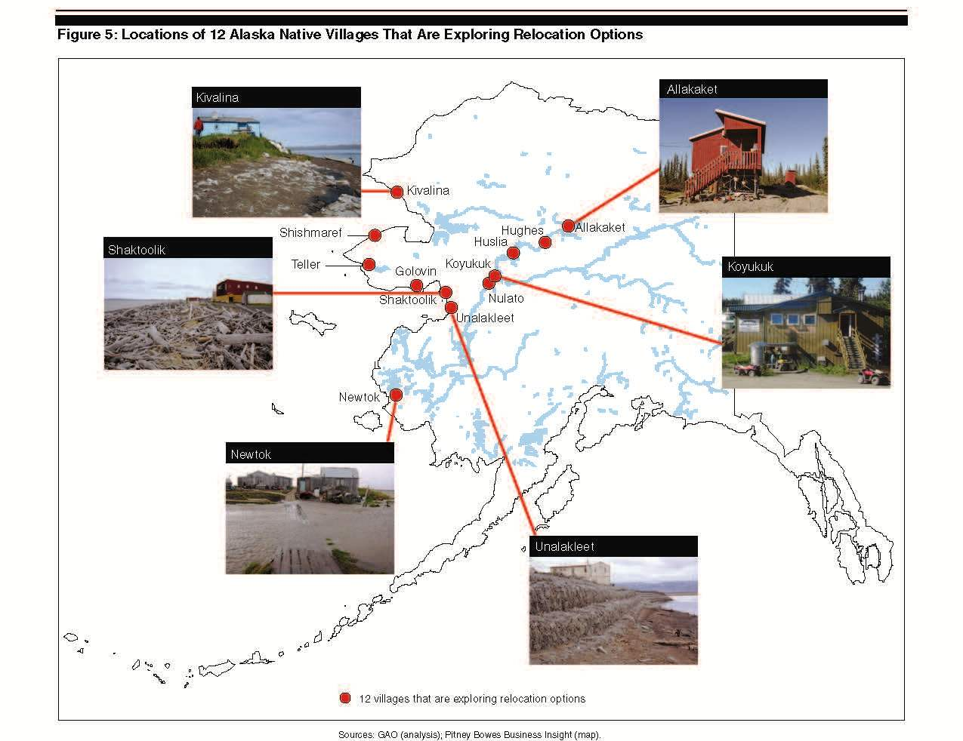

Slide 4
SHISHMAREF
State flood disasters in 2001, 2004 and 2005.
Government spent $16 million on erosion control.
2002 Native Village of Shishmaref voted to relocate. Decided on relocation site but government does not believe it is a good location – still looking for a relocation site.

Slide 5
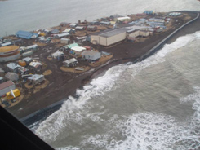
KIVALINA
Between 2002 and 2007, six extreme weather events accelerated the rate of erosion.
Three disaster declarations. The most recent extreme event was a hurricane-strength storm, which occurred in November 2011.
Community has voted three time to relocate and chosen a relocation site

Slide 6
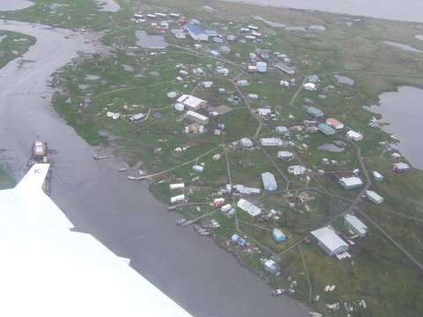
NEWTOK
On-going biophysical change
Erosion Control – Tried and Failed
    $ 1.5 million dollars spent 1983-1989
Six extreme weather events
    1989-2006

Slide 7
SOCIAL-ECOLOGICAL CRISIS
Public Health Crisis
  29% of children have lower respiratory tract infection
Loss of major infrastructure
  Barge landing
  Lack of potable water
  Housing shortage
  Lack of sanitary sewage system

Slide 8
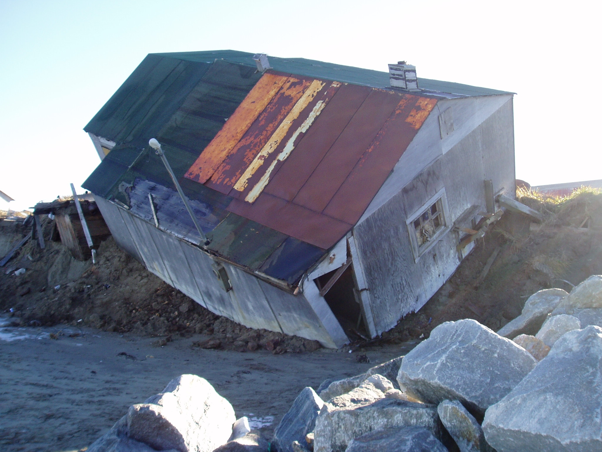
Newtok Traditional Council
NEWTOK TRADITIONAL COUNCIL
Documented erosion since 1983
Identified 6 potential relocation sites and evaluated habitability
Community voted 3 times to relocate
Acquired land for relocation in 2003.

Slide 9
NEWTOK’S RELOCATION CHALLENGES
Newtok Planning Group
  Ad hoc
  25 different federal, state, tribal and non-profit agencies
  No mandate to relocate; no statutory guidance to relocate and no relocation funding
Agencies lack technical, financial and organizational capacity to relocate communities
Statutory barriers
    Can not build school unless at least 10 children enrolled

Slide 10
Alaska State Programs
Alaska Climate Change Impact Mitigation Program
      Funding for six named most threatened communities
  Relocation planning
US Fish and Wildlife Coastal Impact Assistance Program
  Funding to create collaborative governance model

Slide 11
ADAPTIVE GOVERNANCE RESPONSE BASED IN HUMAN RIGHTS
Relocation Policy Framework
* must be based in human rights
* Communities must decide to relocate
* Relocation occurs if it is the only way to protect
Dynamic adaptive governance response
  Disaster relief
  Hazard mitigation
  On-going socio-ecological assessments
  Relocation

Slide 12
SOCIAL-ECOLOGICAL SIGNALS
Repetitive loss of structure;
Imminent danger to community residents;
Community has no further ability to mitigate through flood protection, erosion control;
Number of evacuation incidents;
Socio-economic indicators;
Scientific information regarding predicted sea level rise, erosion and flooding

Slide 13
Recommendations
Congress amend disaster relief legislation to enable communities to use existing funding mechanisms to construct infrastructure at relocation sites that are not within the disaster area.
Congress enact legislation to provide a relocation governance framework so that communities have the ability to relocate when the traditional erosion and flood control devices can no longer protect residents in place.

