Slide 1
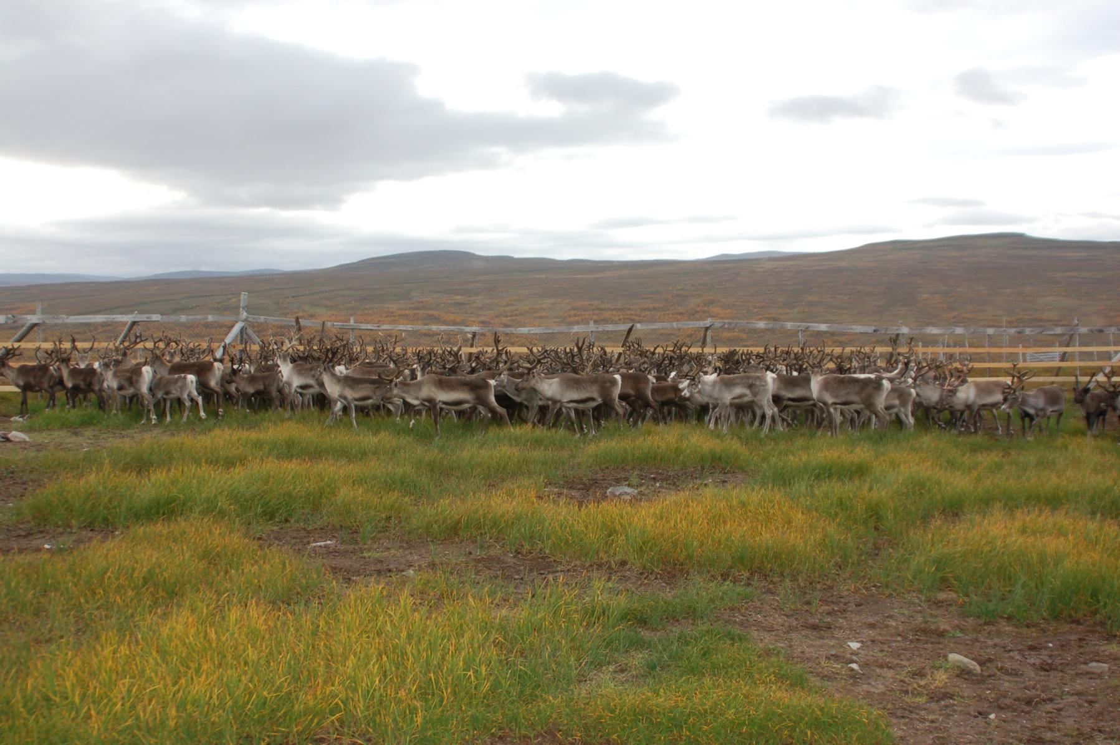

Climate Change, Reindeer Herding, and Policy
Brookings Institution 30.01.2013
Marius Warg Næss, PhD (m.w.nass@cicero.tromso.no)
Notes:
First of all I would like to thank you for the opportunity to give this presentation. I will follow up Ilan’s presentation by going more into detail on how official policies may impact the Saami reindeer herders in Northern Norway.

Slide 2
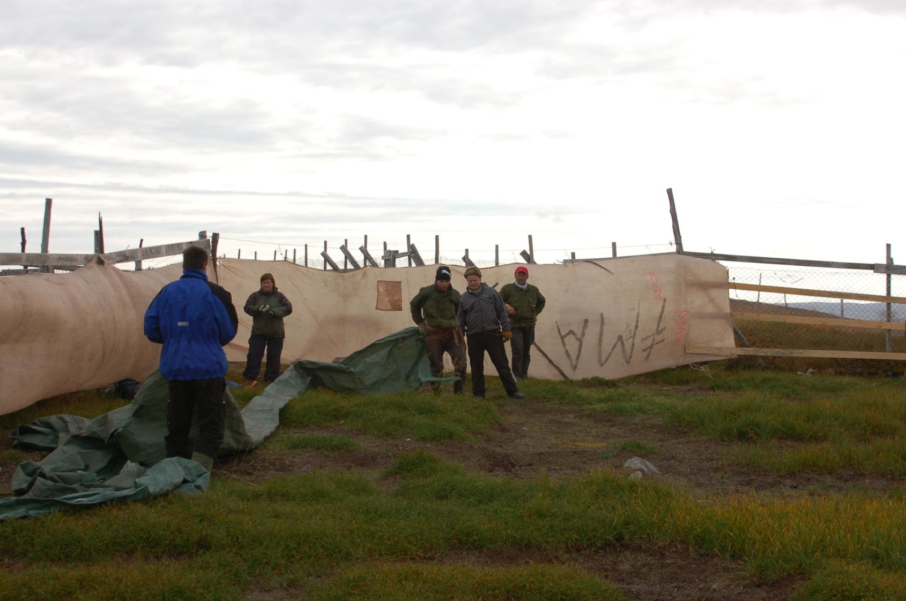

Background
The Norwegian Government aims at developing a
Economic
Ecologic
Cultural
Sustainable reindeer husbandry
Notes:
The Norwegian Government aims at developing a
Economic
Ecologic
Cultural
Sustainable reindeer husbandry
And where sustainability is primarily defined in relation to reindeer abundance

Slide 3
Temporal trends in abundance
Notes:
The underlying rationale is connected to the recent increase in reindeer abundance: the number of reindeer in Norway, especially in Finnmark, has been characterised by considerable temporal variation. After the Second World War, there has been an upward trend in numbers that peaked in the late 1980s or early 1990s, decreased until 2000/2001, and increased in recent years. Two important tools are used by the government to stop this trend:
several economic incentives and subsidies aiming to stimulate reindeer herders to slaughter as many reindeer as possible; and the one I will talk about here
redistributing common winter pastures to smaller units.

Slide 4
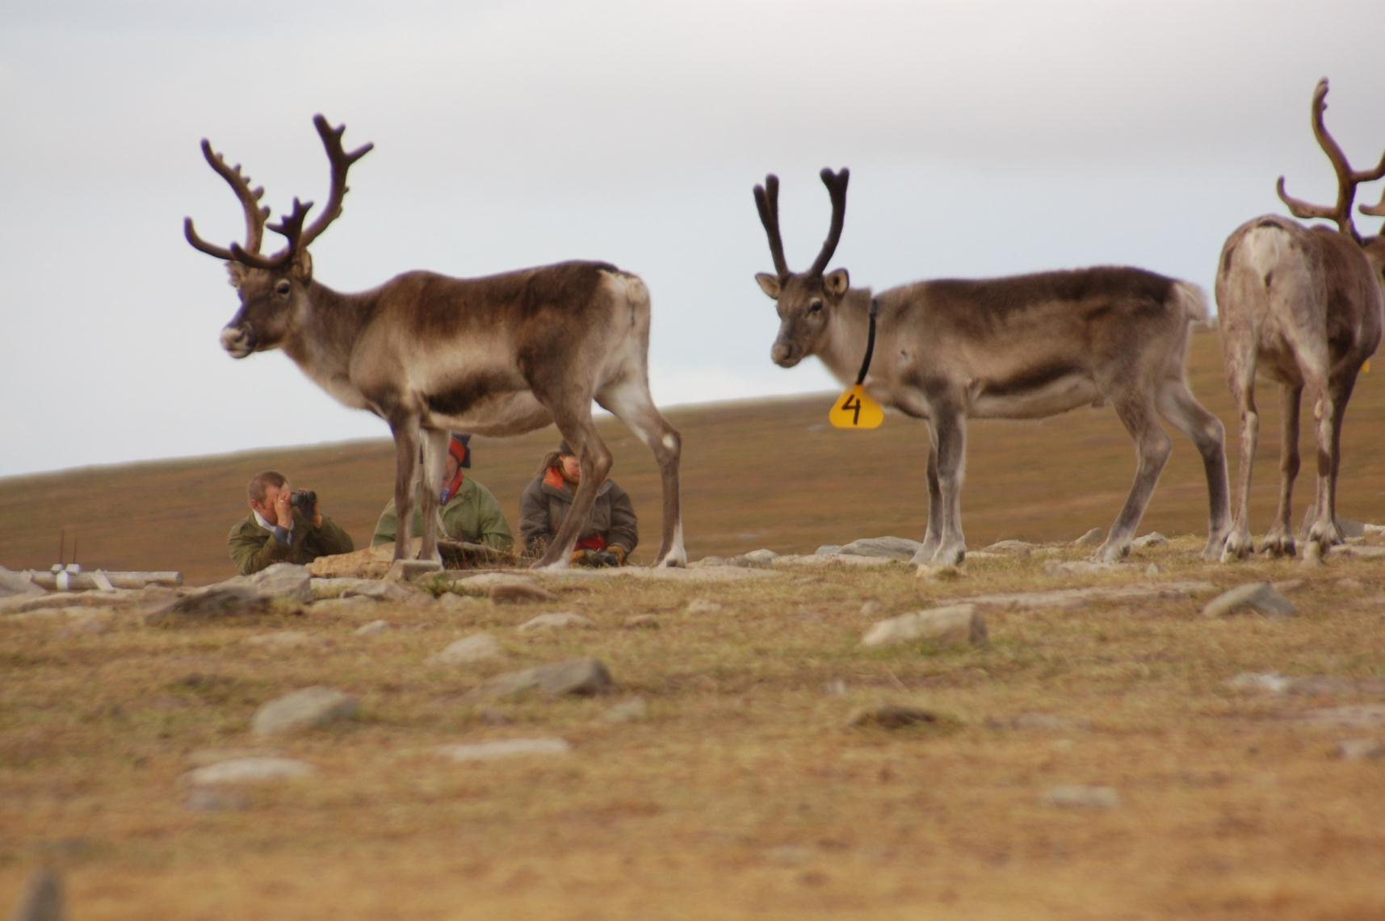
Redistribution of pastures
Underlying rationale
Fixed boundaries is a prerequisite for achieving a sustainable reindeer husbandry¹
¹ The Norwegian Ministry of Agriculture and Food. (2008). St.prp. nr. 63: Om reindriftsavtalen 2008/2009 og om endringer i statsbudsjettet for 2008 m.m.," pp. 24. In Norwegian
Notes:
The Norwegian Ministry of Agriculture and Food provides the underlying rationale for this process: “fixed boundaries that are respected and that does not violate rights established on special legal basis is a fundamental prerequisite for achieving a sustainable reindeer husbandry”.
Originally the redistribution aimed at reinstating power to traditional cooperative groups, namely the siida system, by focusing on giving siidas exclusive user rights to specific winter areas. While not much cause for concern in itself the point I wish to emphasis is that a legal consolidation of siida user rights may be a step towards privatization of previously common grazing area. Importantly, privatization is often followed by exclusive use. Historically, winter pastures was informally regulated according to siida membership where herders had a clear understanding of the fact that different winter pasture areas belonged to different siidas, but when in need everybody had right to access alternative pastures.
The theoretical rationale for privatization is connected to the idea that property rights works as an incentive for sustainable land stewardship.

Slide 5
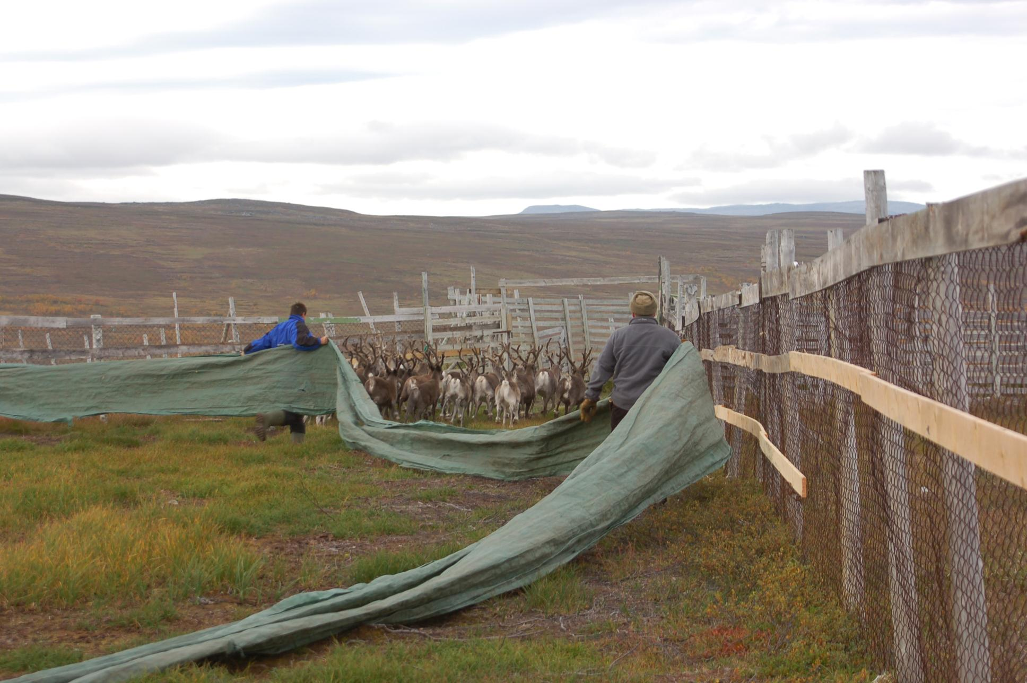
Possible consequences
Comparative evidence suggest that privatization leads to
Increased rangeland degradation
Intensified use
Notes:
This process is on-going in Norway and as such not much evidence exists as to how this may influence herders. Nevertheless, considerable evidence from both Africa and Asia suggest that while privatization has often been launched to counter degradation, the opposite has been the case because privatization results in intensification because grazing is undertaken all-year-round in smaller parcels of land.

Slide 6
Possible consequences
Comparative evidence suggest that privatization leads to
Increased differences between poor and rich
Rich herders have access to more grazing areas
Notes:
At the same time evidence also suggest that privatization has resulted in increased differences between rich and poor, mainly because rich herders usually are in a power position and have been in a position to secure the largest and best tracts of land. As privatization precludes re-allocation of grazing areas the distinction between rich and poor herders is maintained.

Slide 7
Possible consequences
Comparative evidence suggest that privatization leads to
Reduced flexibility for dealing with environmental variation
Mobility decreases
Notes:
Importantly, privatization is a source of fragmentation of rangelands, meaning the dissection of natural systems into spatially isolated parts. This again restricts the movement of both people and livestock and as a consequence, the ability to respond to environmental variability has decreased.

Slide 8
Possible consequences
Comparative evidence suggest that privatization leads to
Increased transaction costs
Monitoring and fencing
Notes:
Furthermore, privately delineated grazing areas often needs to be protected from encroachment by other herders. Consequently, both time and money have to be spent on monitoring or the erection and maintaining of fences.

Slide 9
Possible consequences
Comparative evidence suggest that privatization leads to
Increased levels of conflict
Fenced in rangelands precludes negotiation
Notes:
Similarly, while clear boundaries often are assumed to decrease conflicts, the opposite has also been the case and where fuzzy boundaries have been argued to be open for negotiation while fenced in rangelands precludes negotiation.

Slide 10
Possible consequences
Comparative evidence suggest that privatization leads to
Erosion of social networks
Cooperation is hindered
Notes:
Finally, privatization assumes that production is individually based and that privatization actually increase production efficiency. In contrast, pastoral production is often done collaboratively where both day-to-day herding and seasonal movement are undertaken together with neighboring households. As such, rather than increase efficiency, privatization may decrease it.

Slide 11
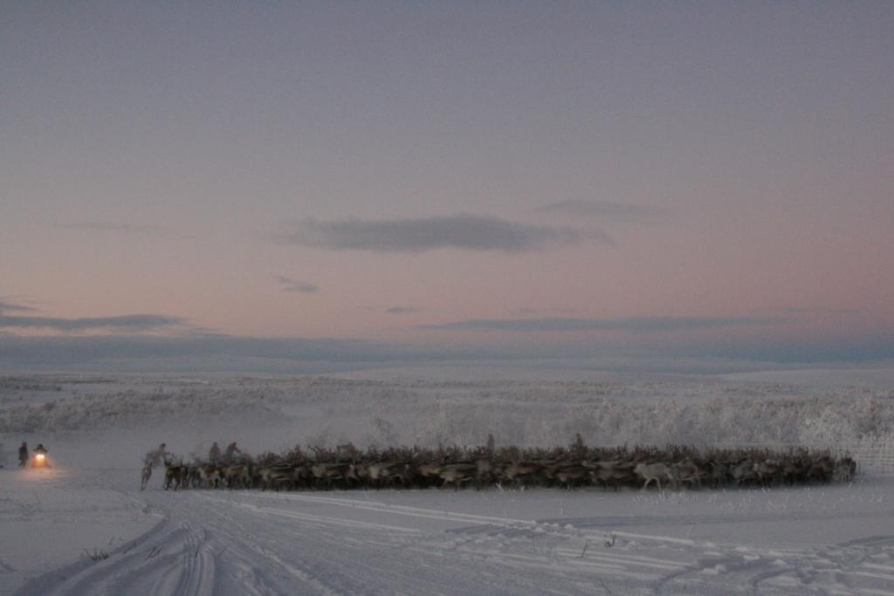
Climate change & Policy
Thanks for the attention!
m.w.nass@cicero.tromso.no
Climate change
Increased environmental variability
Official policy
Diminishes herders’ ability to respond
Photo: Bård-Jørgen Bårdsen
Notes:
It has been argued that by reinforcing the traditional strategies pastoralists have developed to deal with climate variability, the economic, social, and cultural well-being of pastoral societies can be supported in the face of climate change. Moreover, a case has been made that pastoralists are in a unique position to tackle climate change due to extensive experience managing environmental variability and it has been argued that the ability to withstand environmental shocks is a defining feature of pastoralism.
As seen, comparative evidence indicate that rather than helping to alleviate possible problems related to climate change, governmental policies reduces the ability to flexibly respond to environmental variation and in the end, it may be official policies and not climate change per se that represents the greatest challenge for pastoral adaptability.
I also like to point to the fact that it has been argued that properly managed rangelands are estimated to store up to 34% of the global stock of CO2. Moreover, ‘soils represent the earth’s largest carbon sink that can be controlled and improved (even larger than forests) and where grassland management is the second most important agricultural technology available for climate change mitigation’. Additionally, appropriate pastoral resource management has been recognized as favorable for: (1) biodiversity conservation; and (2) sustainable land and water management. In other words, appropriate management may not only benefit the pastoralists themselves but may very well have important impacts for climate change mitigation. Key barriers are official policies that disregards the inherent logic of pastoral strategies.
Thank you very much for you attention and please contact my if you have any feedback or questions!

