Slide 1
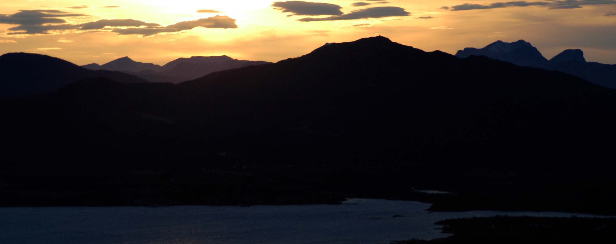
Migration Implications of Resource Extraction for Indigenous Scandinavians
Ilan Kelman, CICERO, Norway

Slide 2
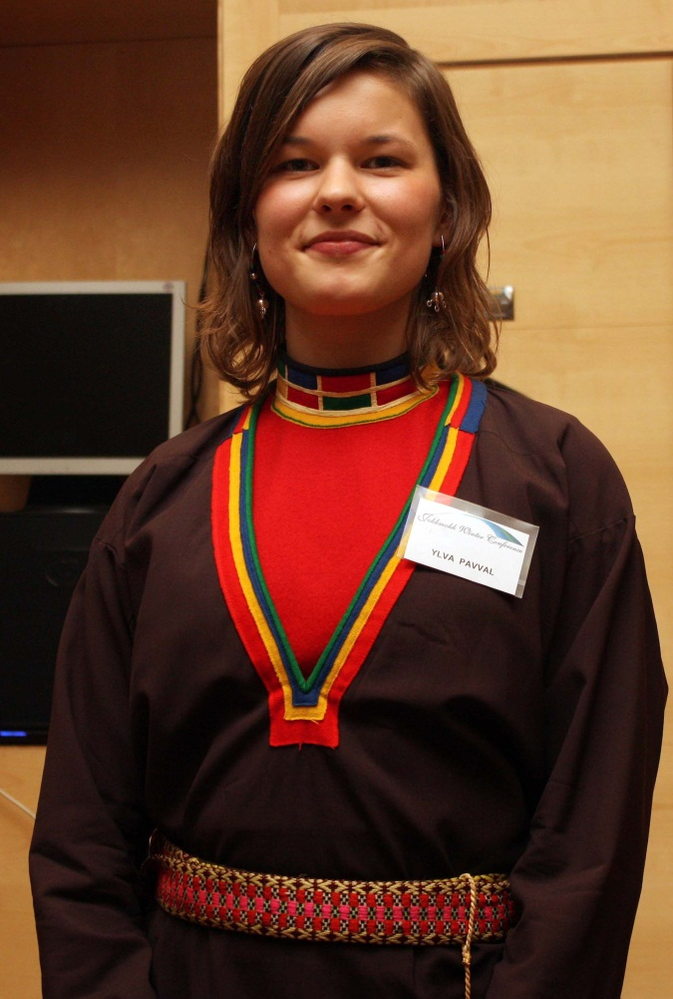
Indigenous Arctic Scandinavians: Saami
Live in Finland, Norway, Sweden, and Russia
Traditionally: reindeer herding, fishing, farming.
Today, a mix of traditional and modern.

Slide 3
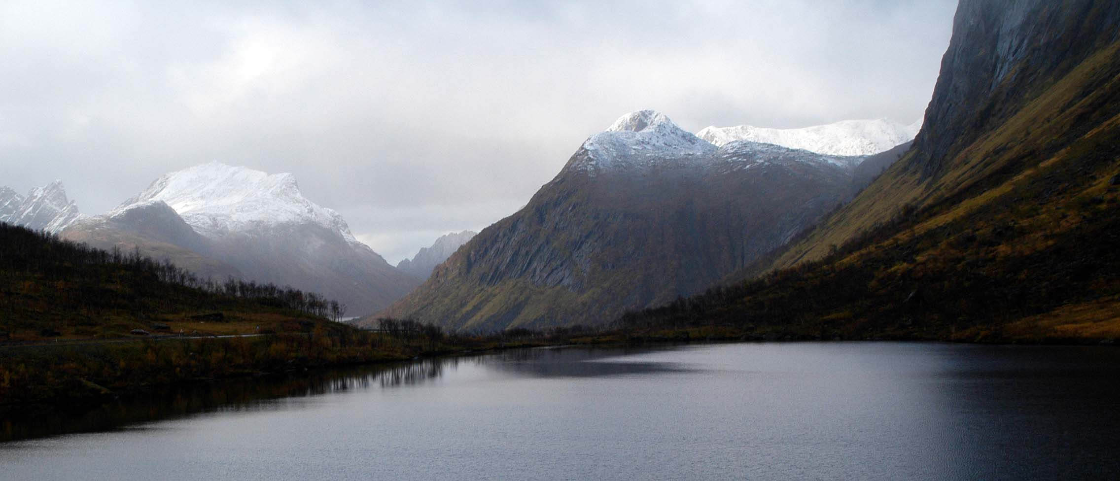
Resources and the Saami
Hydroelectric power, forests.
Oil, gas, minerals.

Slide 4
Migration Implications
Out-migration:
Interfering with traditions.
Disconnected from heritage.
In-migration:
Temporary workers.
Business opportunities.

Slide 5
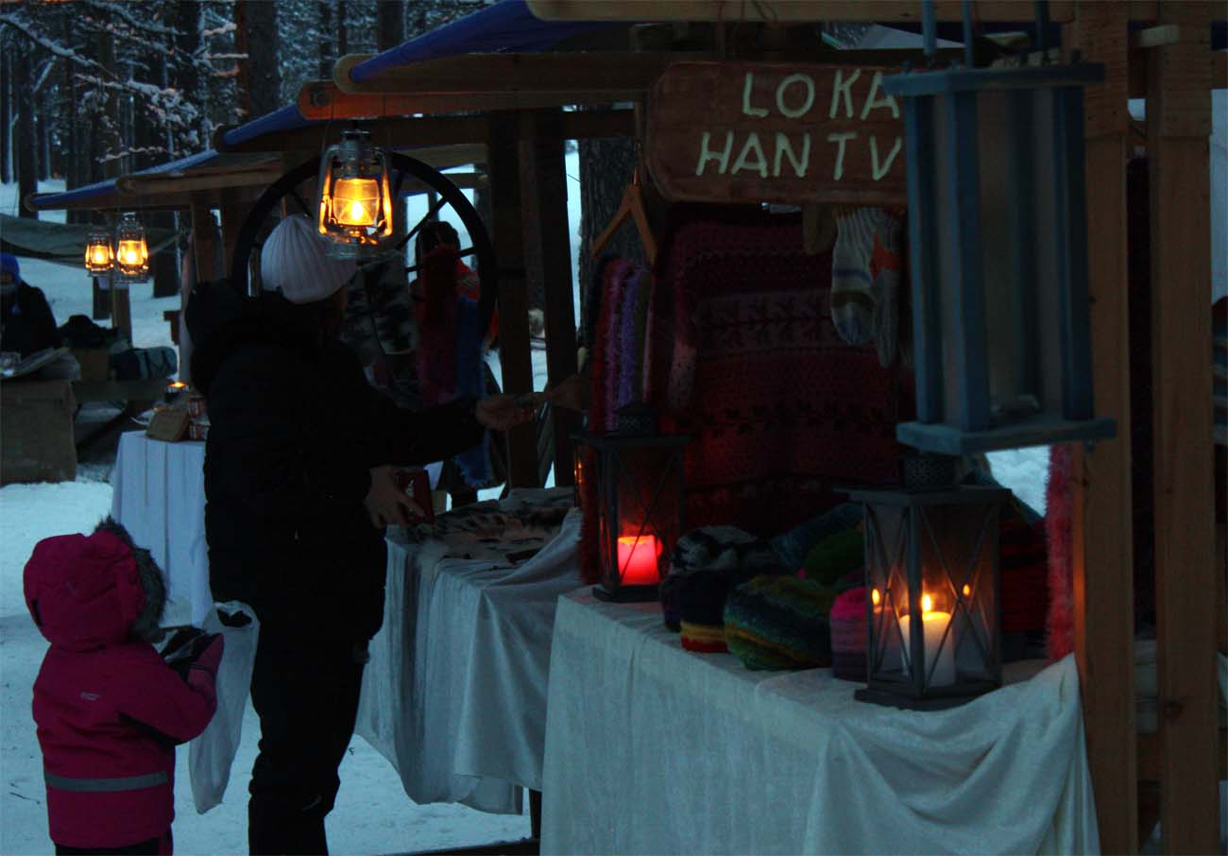
Jokkmokk, Sweden: Winter Conference and Market

Slide 6
Conclusions
Climate change itself has limited impact on displacement.
Social and governance structures limit adaptation and local power.
That can harm indigenous interests.
kelman@cicero.oslo.no

