Slide 2
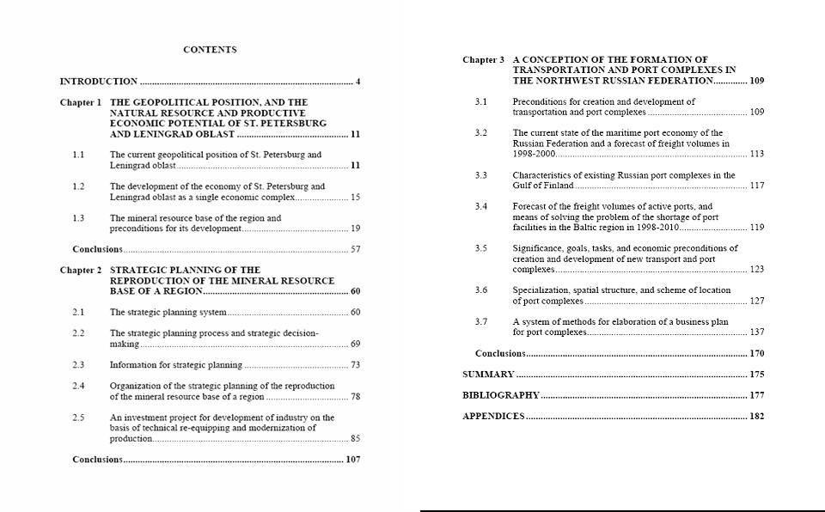

Slide 3
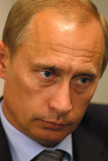
Vladimir Vladimirovich Putin
 | Vladimir Putin was born in Leningrad on October 7, 1952. In 1975, he graduated with a degree in law from Leningrad State University. He later earned a Ph.D. degree in economics. After graduation, Mr. Putin was assigned to work in the KGB. From 1985 to 1990, he worked in East Germany. In 1990, he became assistant to the rector of Leningrad State University responsible for international affairs. [Text from official presidential website]

Slide 4


Slide 5
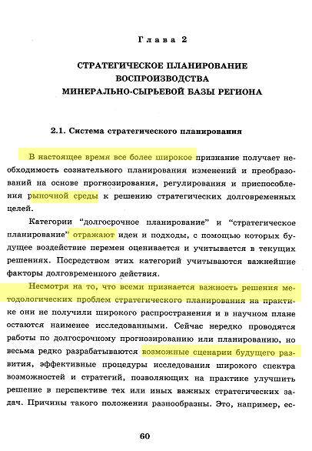
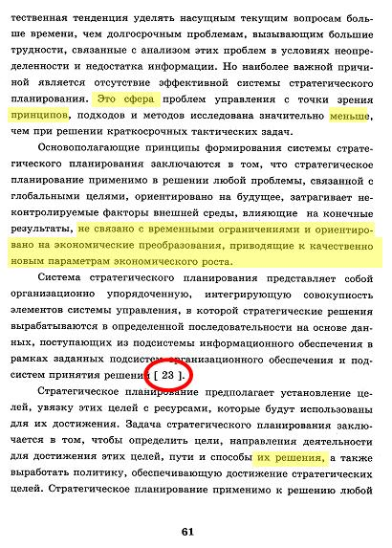

Slide 6
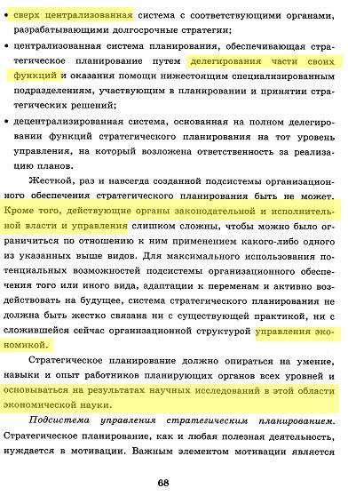
In sum:
More than 16 pages worth of text copied virtually word for word.
No quote marks used, ever.
King & Cleland reference number “[23]” cited twice.
No other direct attribution, no mention of K&C’s names.
Six diagrams and tables lifted directly or slightly modified from K&C with no attribution whatever.

Slide 7
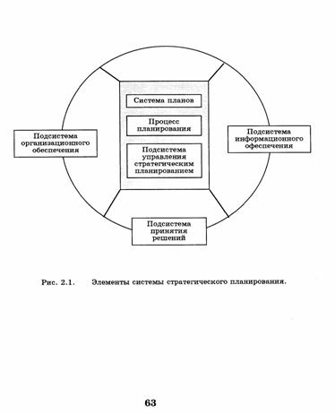
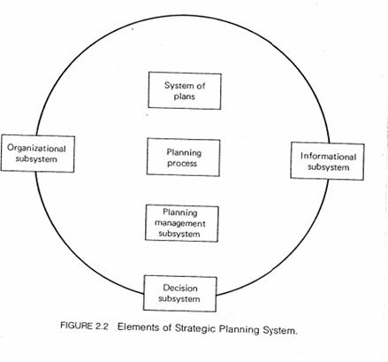

Slide 8
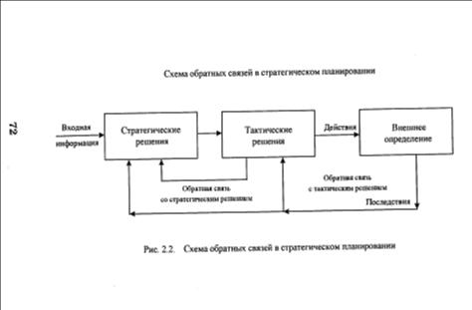
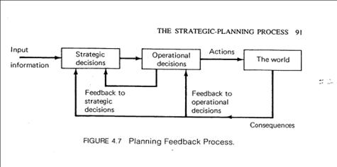

Slide 9
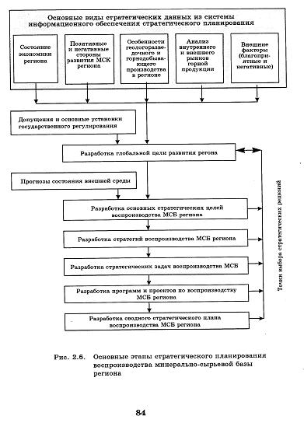
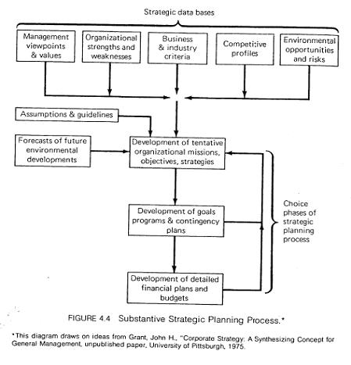

Slide 10
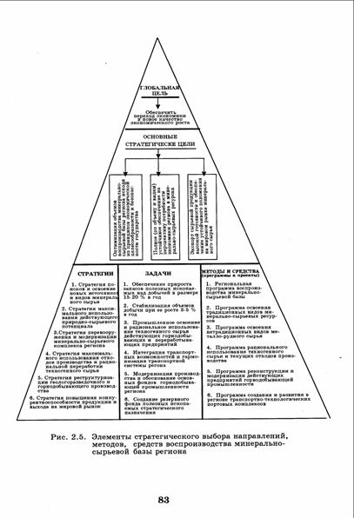
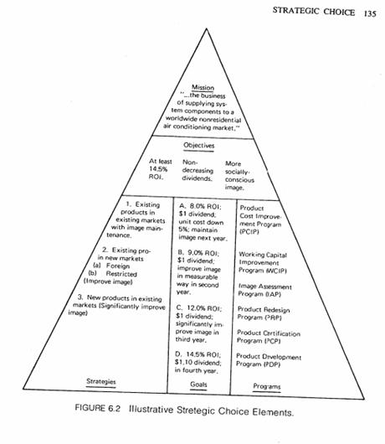

Slide 11
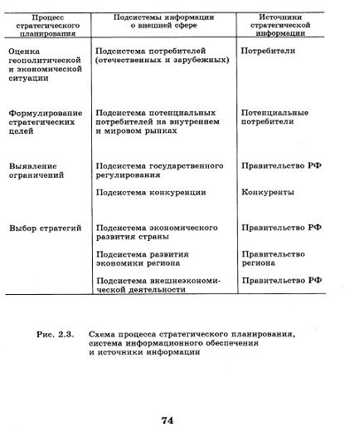
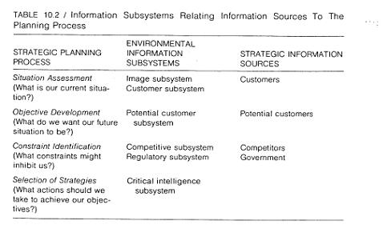

Slide 13
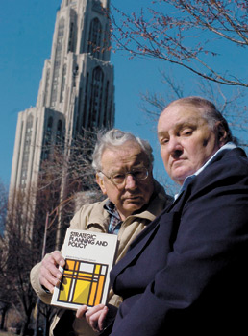
“University of Pittsburgh professors David I. Cleland (left) and William R. King hold their 1978 textbook Strategic Planning and Public Policy, which Russian President Vladimir Putin is accused of plagiarizing in his 1997 economics dissertation.”
Photo: Jasmine Gehris
Pittsburgh Tribune-Review,
March 28, 2006

Slide 14
Afterword: Has Mr. Putin learned to be more careful about plagiarism?
March 2006: Gaddy reveals plagiarism in Putin’s dissertation.
April 2006: Firestorm in Russia on issue
April 3 Kommersant Vlast’ has cover story
“Nashi” leads protests against Gaddy outside US embassy in Moscow
May 2006: In Putin’s “Poslanie,” he quotes from FDR, and then says ...

Slide 15
«Хорошие слова. Жалко только, что не я их придумал. (Аплодисменты).»
-- Владимир Владимирович Путин
Послание Федеральному Собранию Российской Федерации Москва, Кремль, Мраморный зал 10 мая 2006 года

Slide 16
“Nice words. A pity only that I wasn’t the one who thought of them. (Аpplause).»
-- Vladimir Vladimirovich Putin
Message to the Federal Assembly of the Russian Federation
Moscow, Kremlin, Marmor Hall May 10, 2006

