Slide 1
State Strategies for Detecting Fiscal Distress in Local Governments: Study shows how states monitor the fiscal health of localities
July 12, 2016
Hutchins Center on Fiscal and Monetary Policy, The Brookings Institution
Municipal Finance Conference

Slide 2
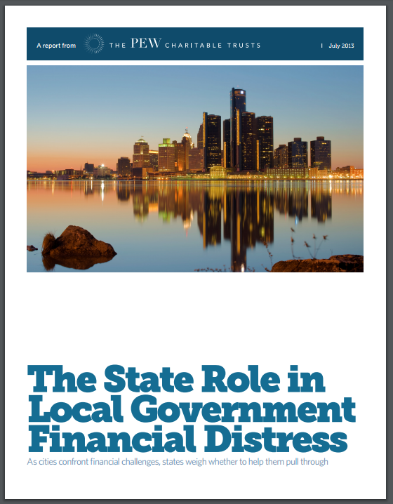
2013 report on state interventions:

Slide 3
Fiscal monitoring defined:
We looked for states that actively and regularly review financial information from local governments with the aim of trying to detect fiscal distress or, more generally, assessing the fiscal condition of local governments.

Slide 4
What we included in our study:
General purpose local governments
Counties, cities, towns, and villages

Slide 5
Fiscal monitoring states
WA
MN
OR
NY
SD
MI
IA
PA
OH
NH
RI
CT
NJ
MD
NV
CO
KY
NC
TN
NM
LA
FL
Fiscal monitoring
No monitoring

Slide 6
Early warning states
WA
MN
OR
NY
SD
MI
PA
IA
PA
OH
NV
OH
NH
RI
CT
NJ
MD
NV
CO
KY
NC
NC
TN
NM
LA
LA
Fiscal monitoring
Fiscal monitoring with early warning
No monitoring
FL

Slide 7
Varying approaches
Handled by departments of revenue, treasury, finance, economic development, auditor, and comptroller.
Variety of methods, indicators used to detect distress.
Attitudes about monitoring also vary.

Slide 8
Key principle #1
Formal systems and processes help to promote transparency, predictability, and consistency.

Slide 9
Key principle #2
Detecting distress early can help local governments to address their fiscal problems before they become unmanageable.
Early warning states: Louisiana, Nevada, New Jersey, North Carolina, Ohio, Pennsylvania, and Rhode Island.

Slide 10
Key principle #3
Good working relationships between state and local governments are critical.

Slide 11
Key principle #4
States should undertake fiscal monitoring with the goal of avoiding state intervention, or taking over a local government’s decision-making authority.

Slide 12
Conclusion
Broad variety of among fiscal monitoring systems.
Research points to promising approaches to building an effective fiscal monitoring system.
States can play a critical role in local
government fiscal health.

Slide 13

For additional questions or information, please contact:
Lauren Dickinson
ldickinson@pewtrusts.org
202-540-6715
pewtrusts.org/fiscal-health

